Slide 1
STEP
Systematic Tracking of Exchanges in Procurement

Slide 2
Concept
Procurement Plan - The preparation of a realistic procurement plan for a project is critical for its successful monitoring and implementation. As part of the project preparation, the Borrower is required to prepare a preliminary procurement plan which is a detailed and comprehensive procurement plan including all contracts for which procurement action is to take place in the first 18 (eighteen) months of project implementation.
The Borrower shall update procurement plans annually by including contracts previously awarded and to be procured in the next 12 (twelve) months. All procurement plans and their updates or modifications shall be subject to the Bank’s prior review and no objection before implementation.
Prior to 2016 Bank’s no-objection to the Procurement Plan and Bank’s clearance for various procurement actions was conveyed via email to the client. With effect from July 2016, please note that all procurement related documents, contracts, request for No-Objections need to be submitted for the Bank’s clearance Only through STEP.
The Bank’s Electronic No Objection System (ENO) has been integrated with STEP. The function now applies to all no objection steps in a prior review process to provide Bank and Client an interface for exchanging no objection requests, interim responses, and no objection letters. STEP tracks all correspondence exchanges and response times by Bank and Clients.
contd………………………………

Slide 3
basic features
Clients will use STEP initially to create and later to revise Procurement Plans under Investment Project Financing (IPF), and to monitor performance, manage and store related documentation for all steps in a procurement activity. This will include both activities that are prior reviewed by the Bank and contracts subject to post review.
STEP allows Bank and Clients to monitor and track all procurement activities. Clients will determine and record the original time estimates for each step/stage in a specific procurement plan. STEP will capture all revisions to estimates and ultimately record the actual completion dates of all required procurement steps. This information is critical to help the Bank and Client assess the efficiency of the Client’s procurement and the adequacy of the method selected, and make necessary adjustments in future procurement approaches.

Slide 4
basic features
STEP Facilitates - End-to-end Process from Planning to Contract Execution
Recording of all contracts (All Post and prior review activities irrespective of the threshold)
Monitoring of all procurement processes up to contract completion
Tracking all amendments, variation orders, completion dates, and comments/findings during contract execution
Procurement plan
Prior & post
Activity tracking
Process management
Amendments & V.O.
Completion time
Activity planning
Procurement processing
Contract Management

Slide 5
MORE features
United Nation’s Standard Procurement Service Code [UNSPSC] use is mandatory
STEP enables auto publication of approved procurement plan, publication notices and contract award information in the Bank’s external website, UNDB online, World Bank Finances App, and World Bank Procurement App
STEP automatically populates information on any Debarred List /Temporary Suspensions List hit firms when you choose the supplier/contractor/firm name for recommendation of award/shortlist

Slide 6
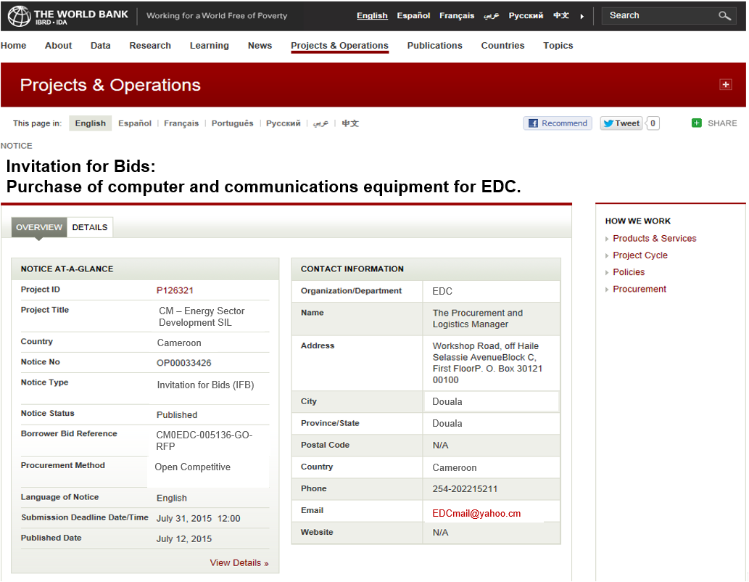
Automatic publication of Procurement Notices
Automated Publication to 4 electronic outlets
United Nations Development Business
www.worldbank.org
World Bank Finances App
World Bank Procurement App
1
2
Automated Publication
3
4

Slide 7
Online resources
This presentation provides an overview of the capabilities and functionality of the Bank’s new Procurement Planning and Tracking System STEP – Systematic Tracking of Exchanges in Procurement. It is an introduction to the system and its value proposition, providing an overview view of the system framework, core features, and functionality.
More information on STEP implementation timelines, support teams, and other learning resources are available on the Bank’s website link given below.
https://wbnpf.procurementinet.org/e-learning-programs

Slide 8
Online resources
# | Name | URL
1 | STEP Overview | https://wbnpf.procurementinet.org/STEP-Overview
2 | Account Registration | https://wbnpf.procurementinet.org/Account-Registration
3 | Create Password and STEP Access | https://wbnpf.procurementinet.org/create-password-and-step-access
4 | STEP Dashboard Overview | https://wbnpf.procurementinet.org/step-dashboard-overview
5 | Project Details | https://wbnpf.procurementinet.org/project-details
6 | Upload PPSD | https://wbnpf.procurementinet.org/upload-ppsd
7 | Create and Submit GPN | https://wbnpf.procurementinet.org/Create-and-Submit-GPN
8 | Create Procurement Plan | https://wbnpf.procurementinet.org/create-procurement-plan
9 | Submit PP and Bank Response | https://wbnpf.procurementinet.org/submit-pp-and-bank-response
10 | Edit Procurement Plan | https://wbnpf.procurementinet.org/edit-procurement-plan
11 | Procurement Plan Features | https://wbnpf.procurementinet.org/procurement-plan-features
12 | Prior Review - Draft BD - Upload Documents | https://wbnpf.procurementinet.org/prior-review-draft-bd-upload-documents
13 | Prior Review - Draft BD - Send to Bank and Bank Response | https://wbnpf.procurementinet.org/prior-review-draft-bd-send-bank-and-bank-response
14 | Prior Review - Upload Issued BD and Notification | https://wbnpf.procurementinet.org/prior-review-upload-issued-bd-and-notification
15 | Prior Review - Specific Procurement Notice | https://wbnpf.procurementinet.org/prior-review-specific-procurement-notice
16 | Prior Review - Amendments to BD | https://wbnpf.procurementinet.org/prior-review-amendments-bd
17 | Prior Review - Bid Opening Minutes | https://wbnpf.procurementinet.org/prior-review-bid-opening-minutes
18 | Prior Review - Bid Validity Extension | https://wbnpf.procurementinet.org/prior-review-bid-validity-extension
19 | Prior Review - BER - Add Firms | https://wbnpf.procurementinet.org/prior-review-ber-add-firms
20 | Prior Review - BER - Evaluated Contracts and Bank's Response | https://wbnpf.procurementinet.org/prior-review-ber-evaluated-contracts-and-banks-response
21 | Prior Review - Standstill and Debriefing | https://wbnpf.procurementinet.org/prior-review-standstill-and-debriefing
22 | Prior Review - Notification of Award | https://wbnpf.procurementinet.org/prior-review-notification-award
23 | Prior Review - Signed Contract and BO Form | https://wbnpf.procurementinet.org/prior-review-signed-contract-and-bo-form
24 | Prior Review - Contract Amendment and Contract Form | https://wbnpf.procurementinet.org/prior-review-contract-amendment-and-contract-form
25 | Prior Review - Contract Completion | https://wbnpf.procurementinet.org/prior-review-contract-completion
26 | Prior Review - Contract Termination | https://wbnpf.procurementinet.org/prior-review-contract-termination
27 | Post Review - Terms of Reference | https://wbnpf.procurementinet.org/post-review-terms-reference
28 | Post Review (CS) - Key Procurement Steps | https://wbnpf.procurementinet.org/post-review-cs-key-procurement-steps
29 | Post Review - Contract Amendment | https://wbnpf.procurementinet.org/post-review-contract-amendment

Slide 9
STEP : Using the System : Preferred Browsers, and URL Preferred Browser : Google Chrome Other browsers that support STEP : Internet Explorer, Firefox Accessing the System : URL : step.worldbank.org Click on : ‘LOGIN’

Slide 10
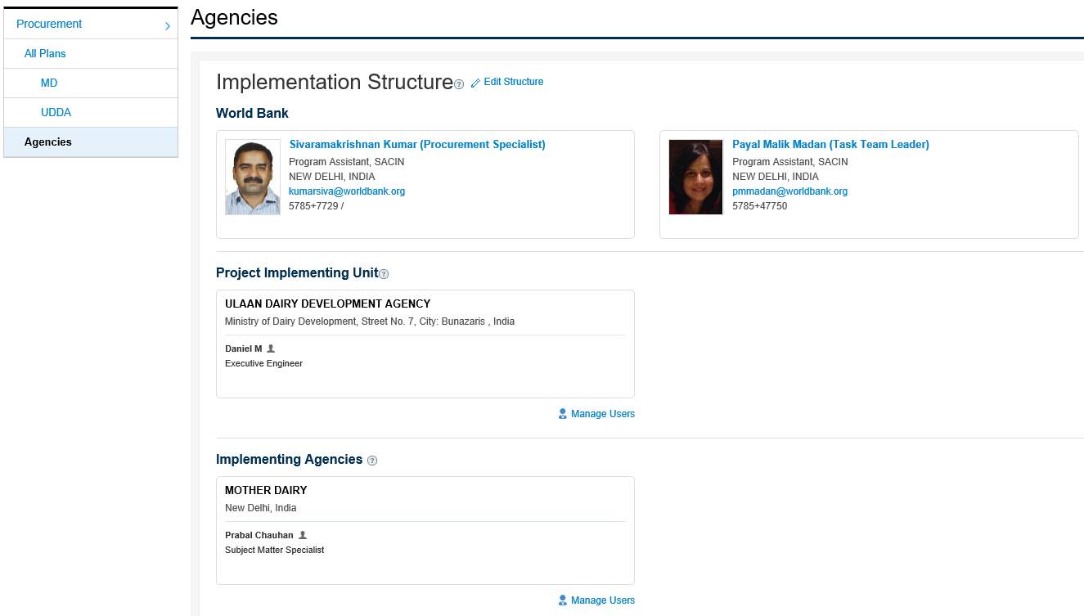
STEP: SETTING UP PROJECT FOR STEP
Users can be added only by the Bank staff after the contact person of the agency sends an email request to the Bank with the user details
Procurement Specialist
Task Team Leader

Slide 11
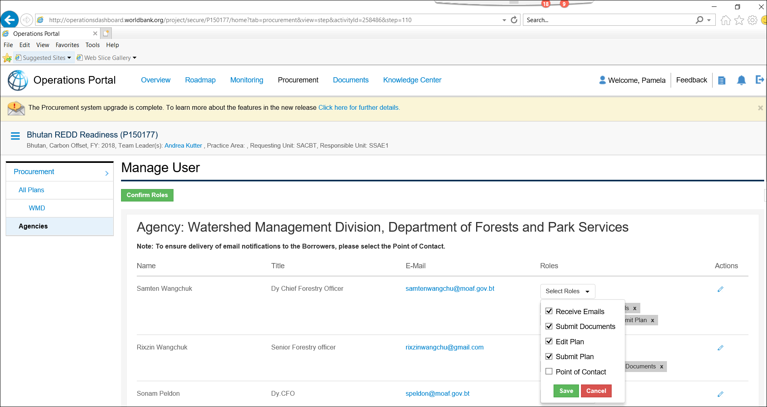
STEP: SETTING UP PROJECT FOR STEP
USER ROLES

Slide 12
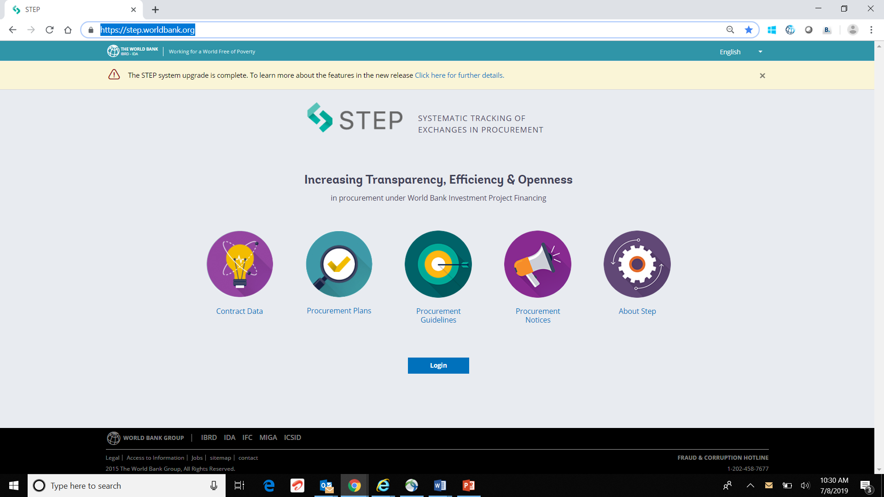
STEP: Website DETAILS
https://step.worldbank.org/

Slide 14
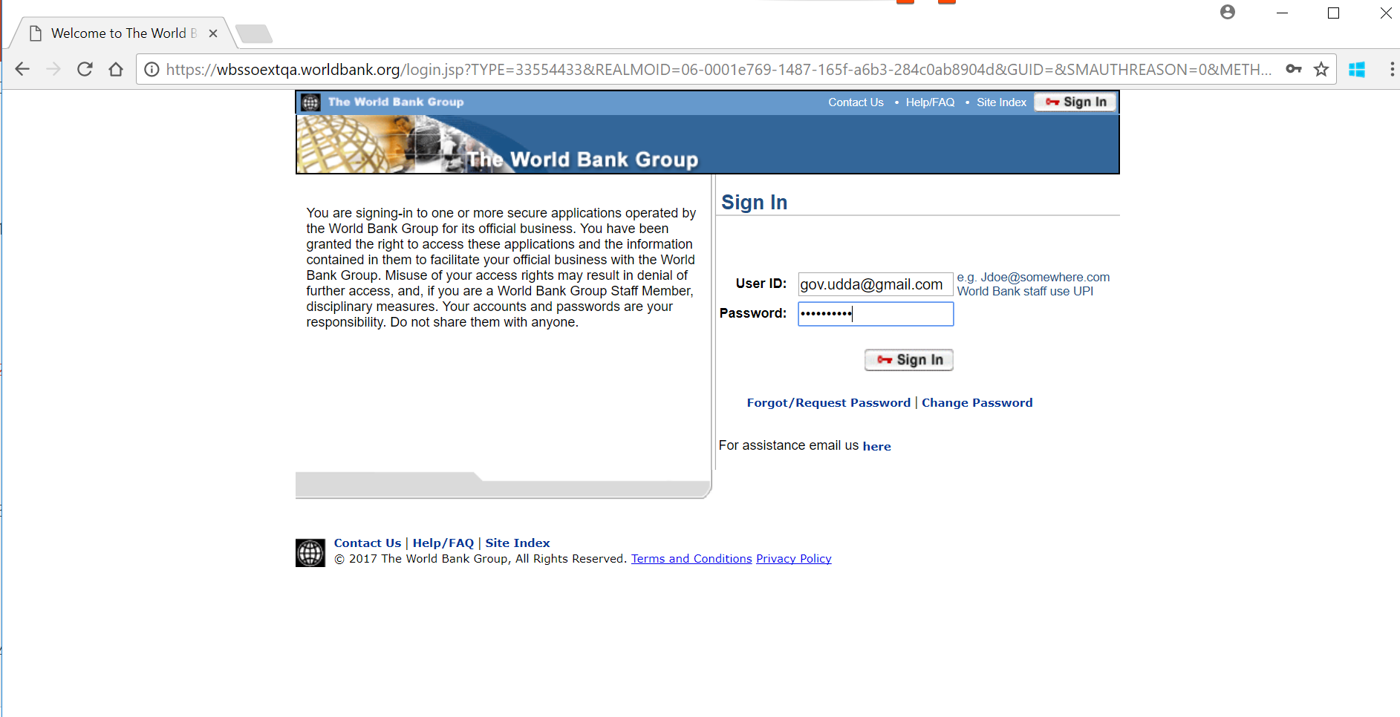

Slide 15
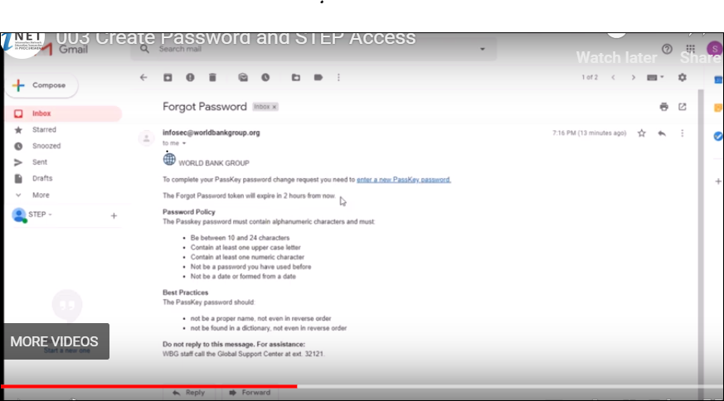
Forgot password email
Sent to the user at his registered email id.

Slide 16
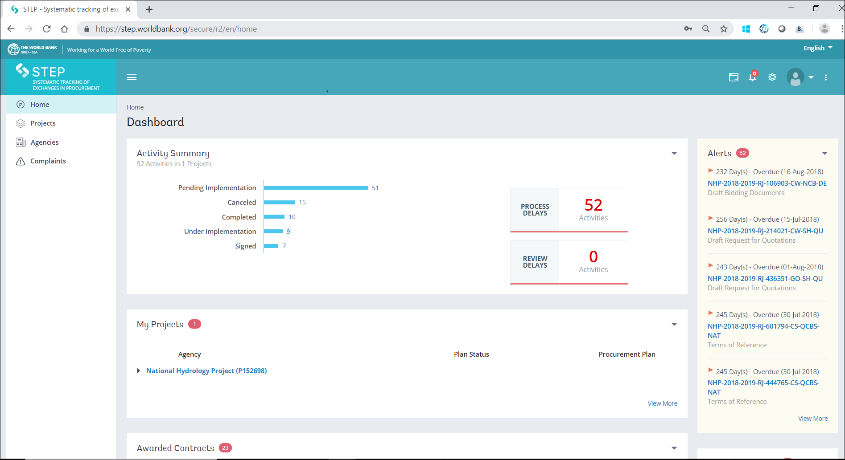
STEP DASHBOARD with a New look
Activity Summary Tab and the other movable widgets on this page

Slide 17
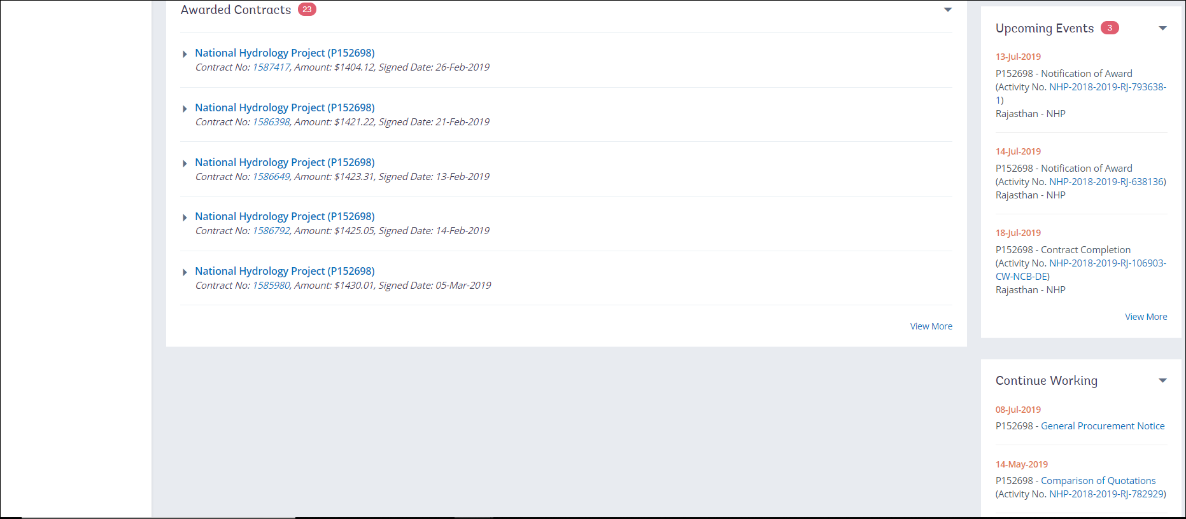
STEP DASHBOARD……………contd.

Slide 18
STEP Enhancement and there after ….
STEP dashboard – New features

Slide 19
STEP dashboard – New features
4 icons on the top right hand corner of the screen
Reset, Recent Notifications, Settings and Templates/Related Information

Slide 20
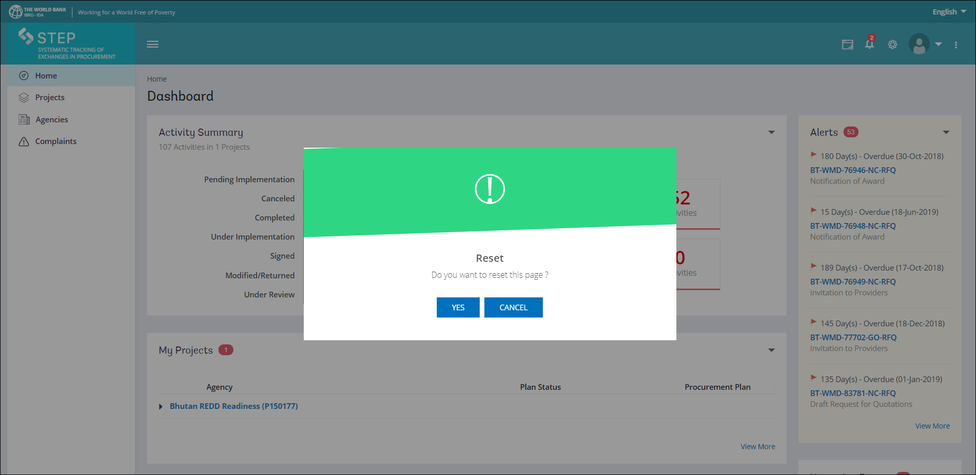
STEP dashboard – New features
Borrower users can now customize user screens and dashboards to their individual needs; by moving the widgets around
Reset icon resets the dashboard to the Default Widget Layout

Slide 21
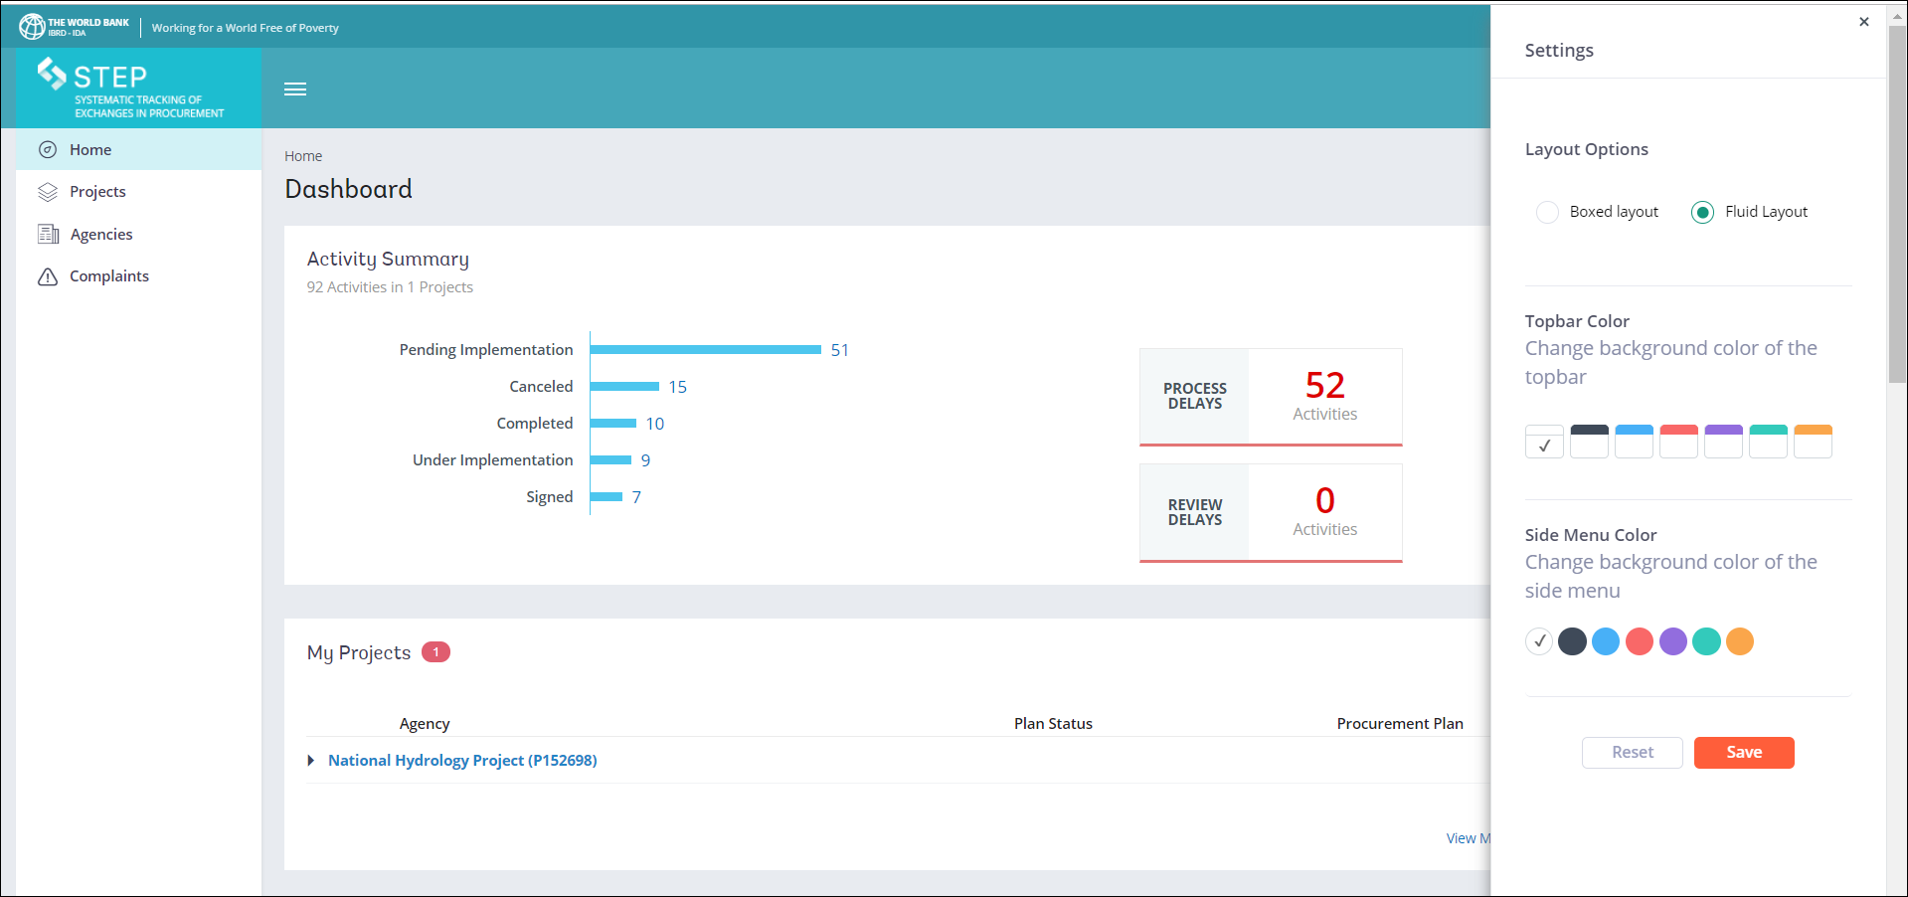
STEP dashboard – New features
Settings icon enables you to customize the Layout Option, Topbar Color and Side Menu color as per your preference

Slide 22
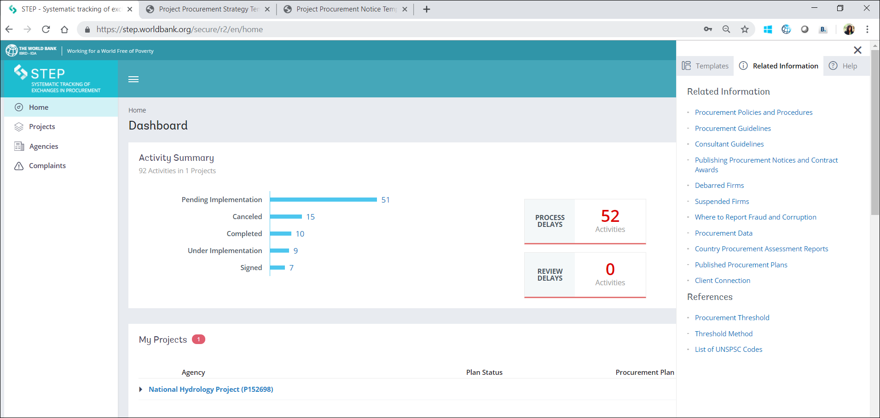
STEP dashboard – New features
Templates/Related Information/Help icon – Last icon shown as 3 dots
Related Information tab is shown in this slide

Slide 23
STEP– Procurement Notices
Client will use STEP to create and publish all procurement notice
General and Specific Procurement Notices, Requests for Expression of Interest
and for Pre-qualifications, and Contract Award Notices
All notices are published in the World Bank’s external website.
While in majority of the procurements the notices are not published in United Nations Development Business (UNDB) unless they are implemented following International Competitive Bidding (ICB) method, however, should there be a requirement, then upon request by the Bank team, these notices are published in the UNDB only for specific and important activities, which are of complex nature irrespective of the method of procurement ie. National Competitive Bidding (NCB) or ICB) ..

Slide 24
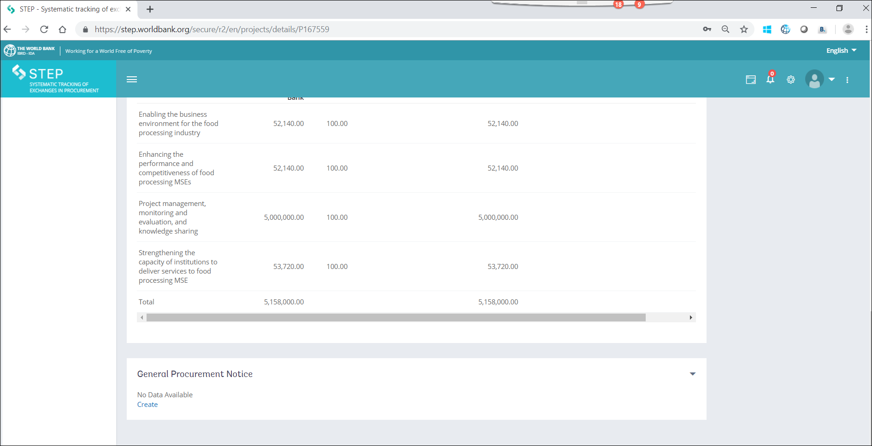
STEP : Creating a General Procurement Notice
At the bottom of the Project Details page is the GPN tab…shown below

Slide 25
STEP : Creating a General Procurement Notice-Step 2

Slide 26
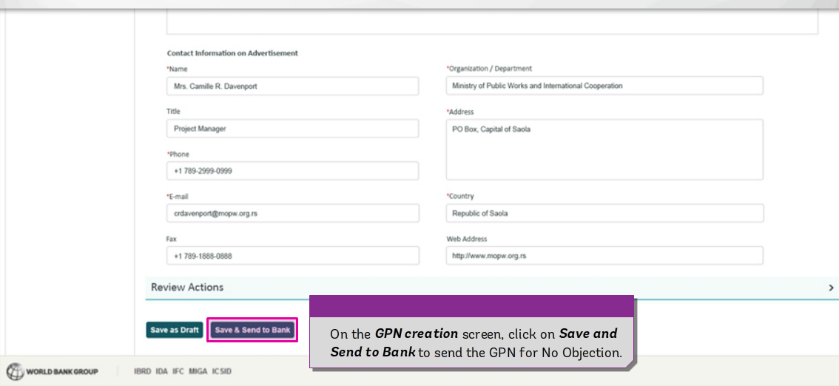
STEP : Creating a General Procurement Notice-Step 3

Slide 27
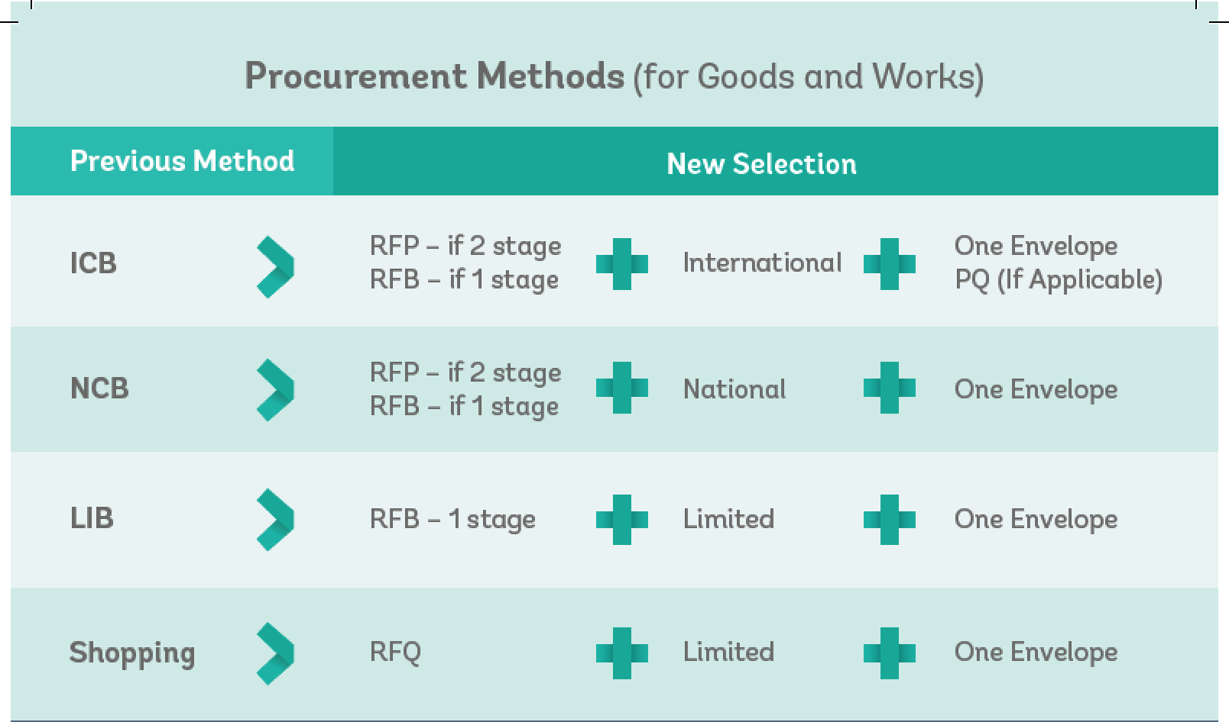
Projects following the New Procurement Framework (NPF), please visit the following website for more information http://wbnpf.procurementinet.org/
Procurement Methods Mapping to NPF

Slide 28
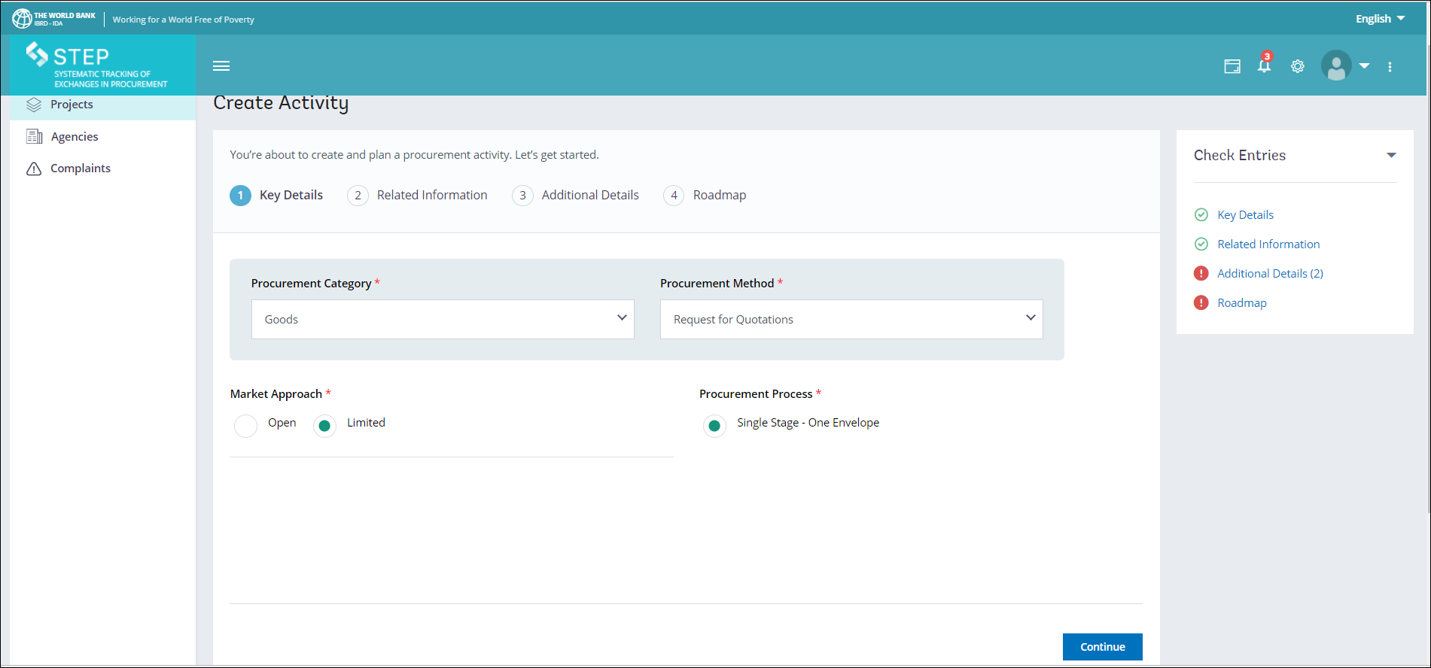
Create Activity
4 tabs under Create Activity – Key Details, Related Information, Additional Details and Roadmap
New Feature – Check Entries which is on the right side of this page
Key Details tab is shown on the slide below

Slide 29
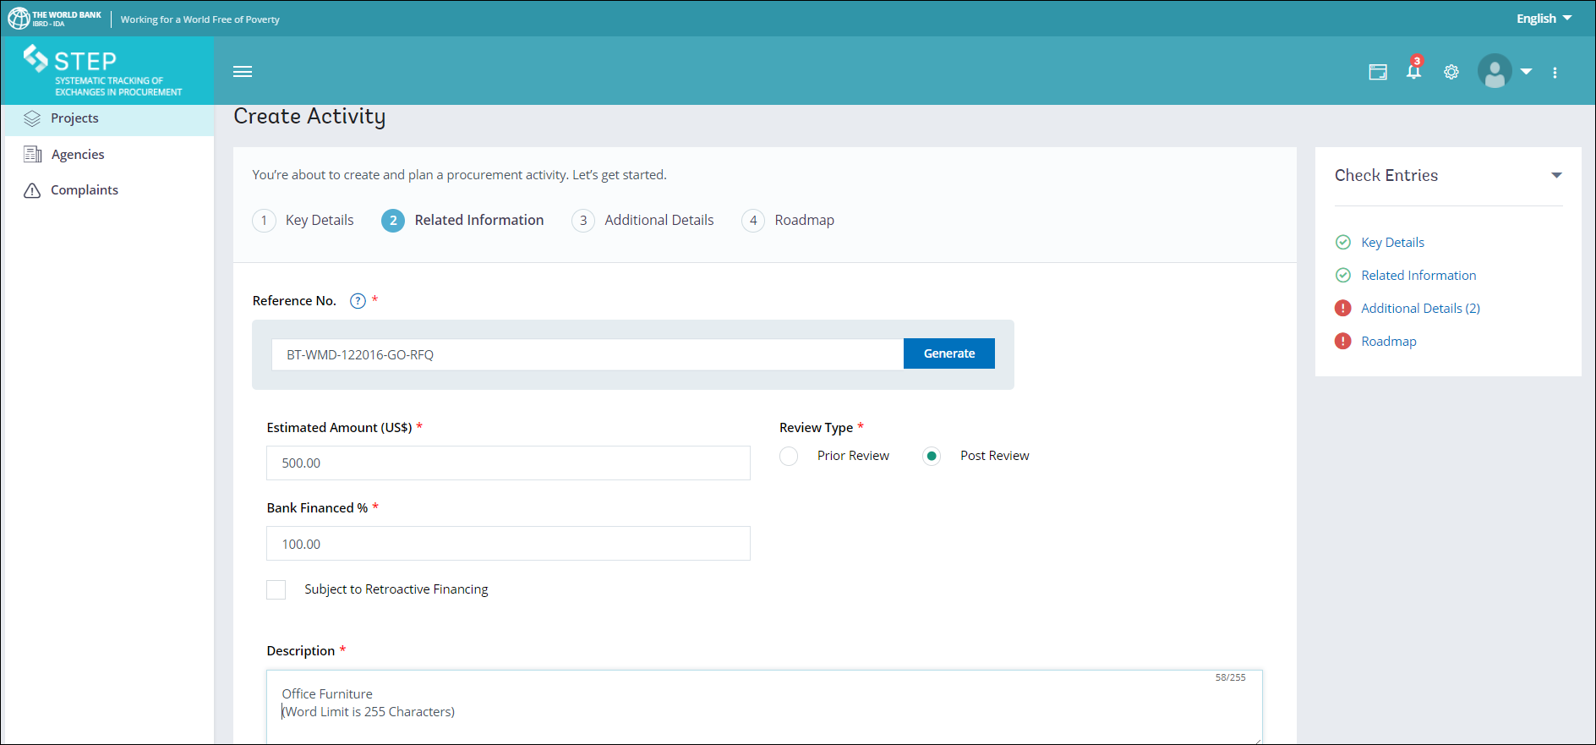
Create Activity
Related Information Tab

Slide 30
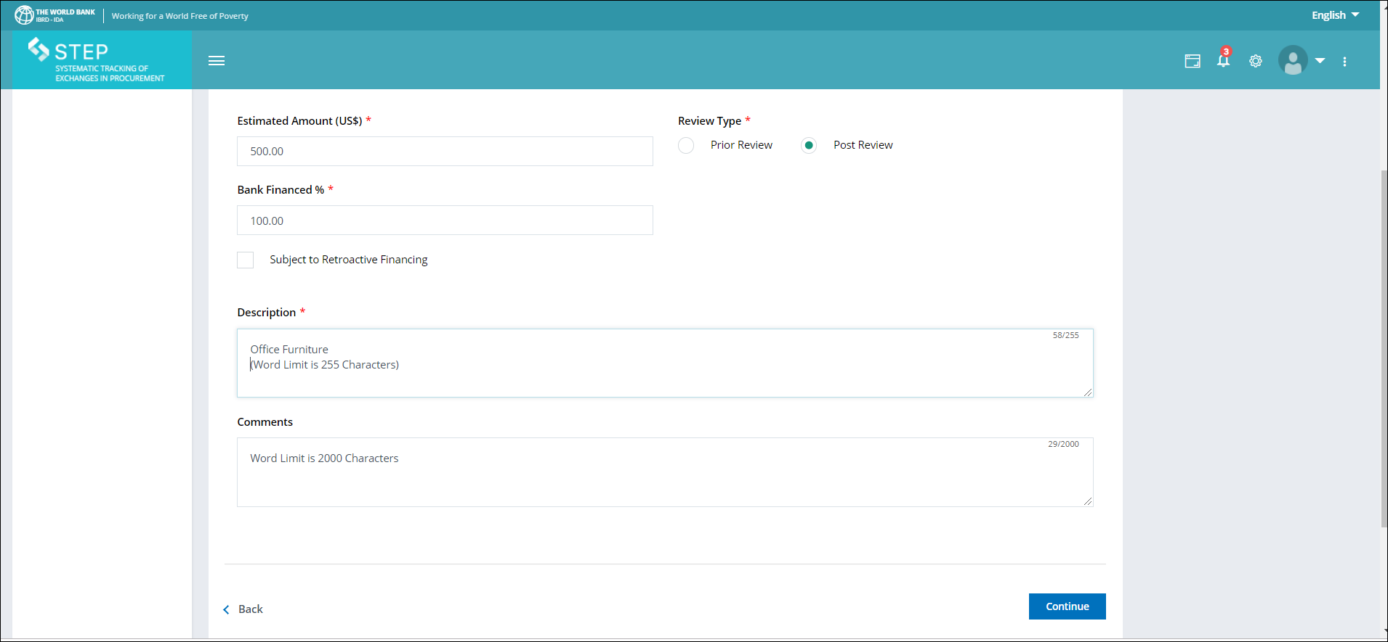
Create Activity
Related Information Tab………contd.
Please note the Comments tab
Click on continue on each page where you see Save/continue
Specially in the case of Single Source and Direct Contracting where justification is required kindly provide adequate justification in the space provided.

Slide 31
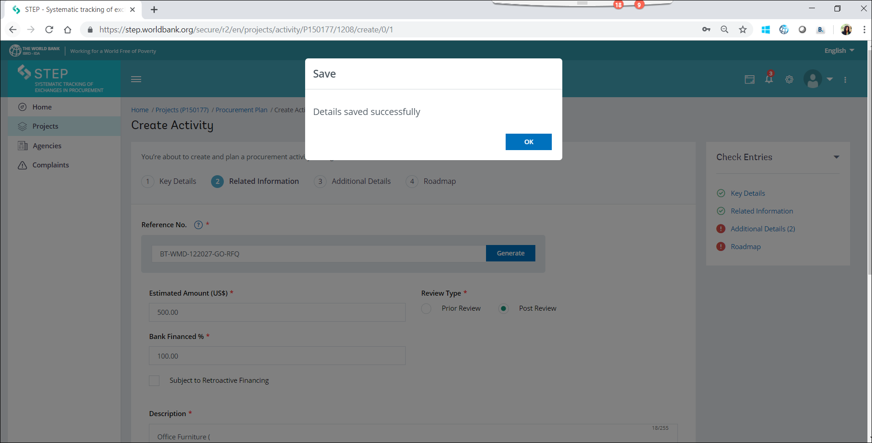
Create Activity
Saving details of the activity

Slide 32
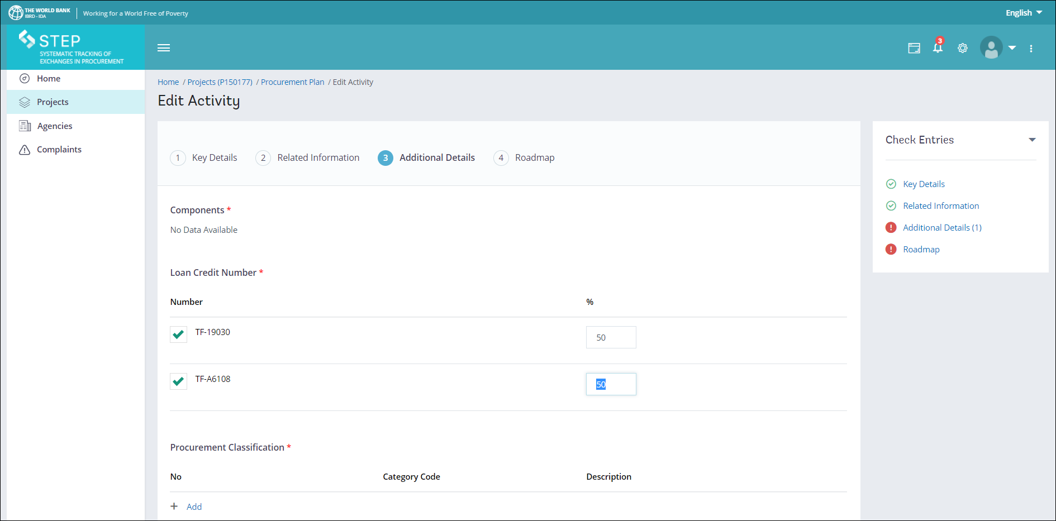
Create Activity
Additional Details Tab

Slide 33
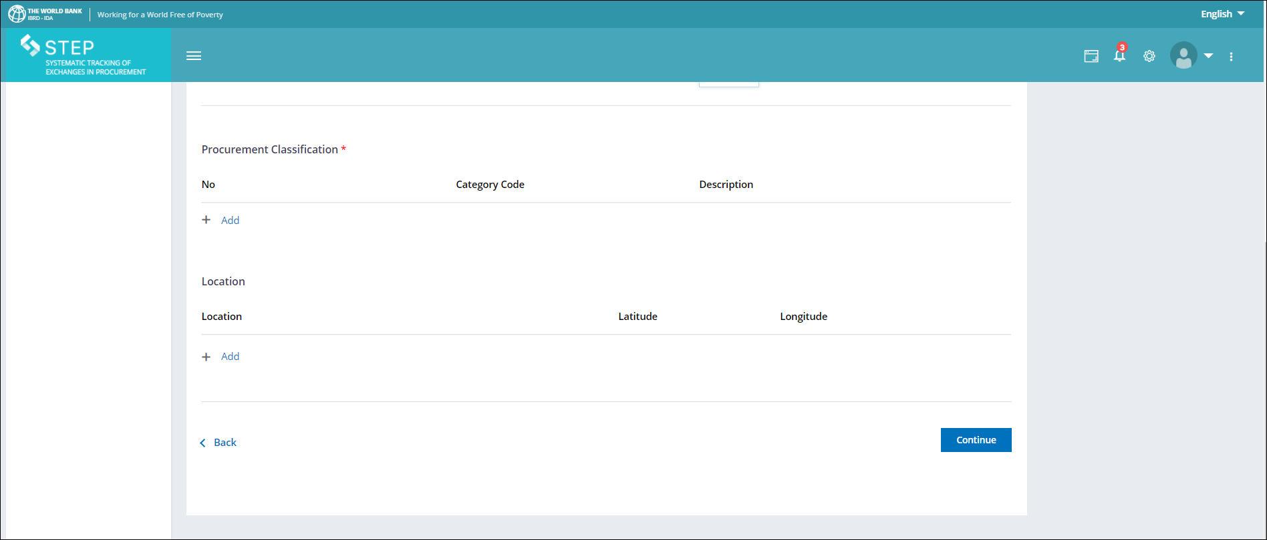
Create Activity
Additional Details Tab……………….contd.

Slide 34
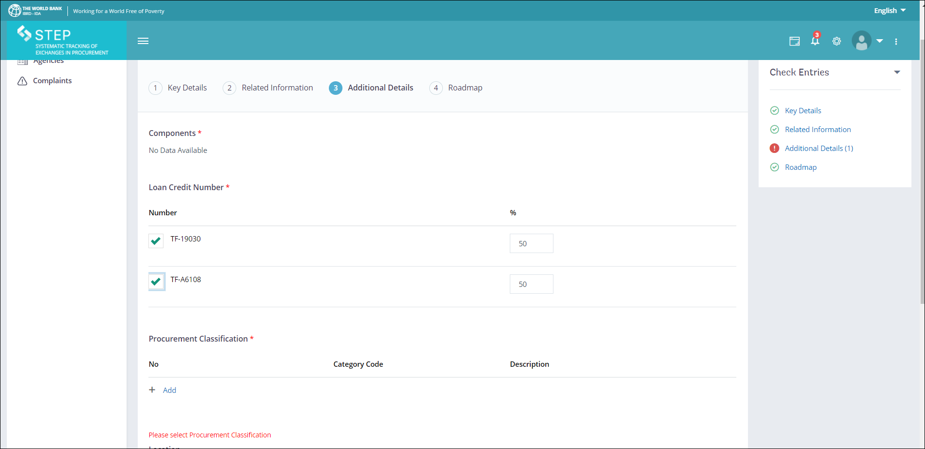
Create Activity
Check entries……….while creating an activity
Procurement Classification is missing under the Additional Details tab hence this tab is shown under Check entries with a red dot

Slide 35
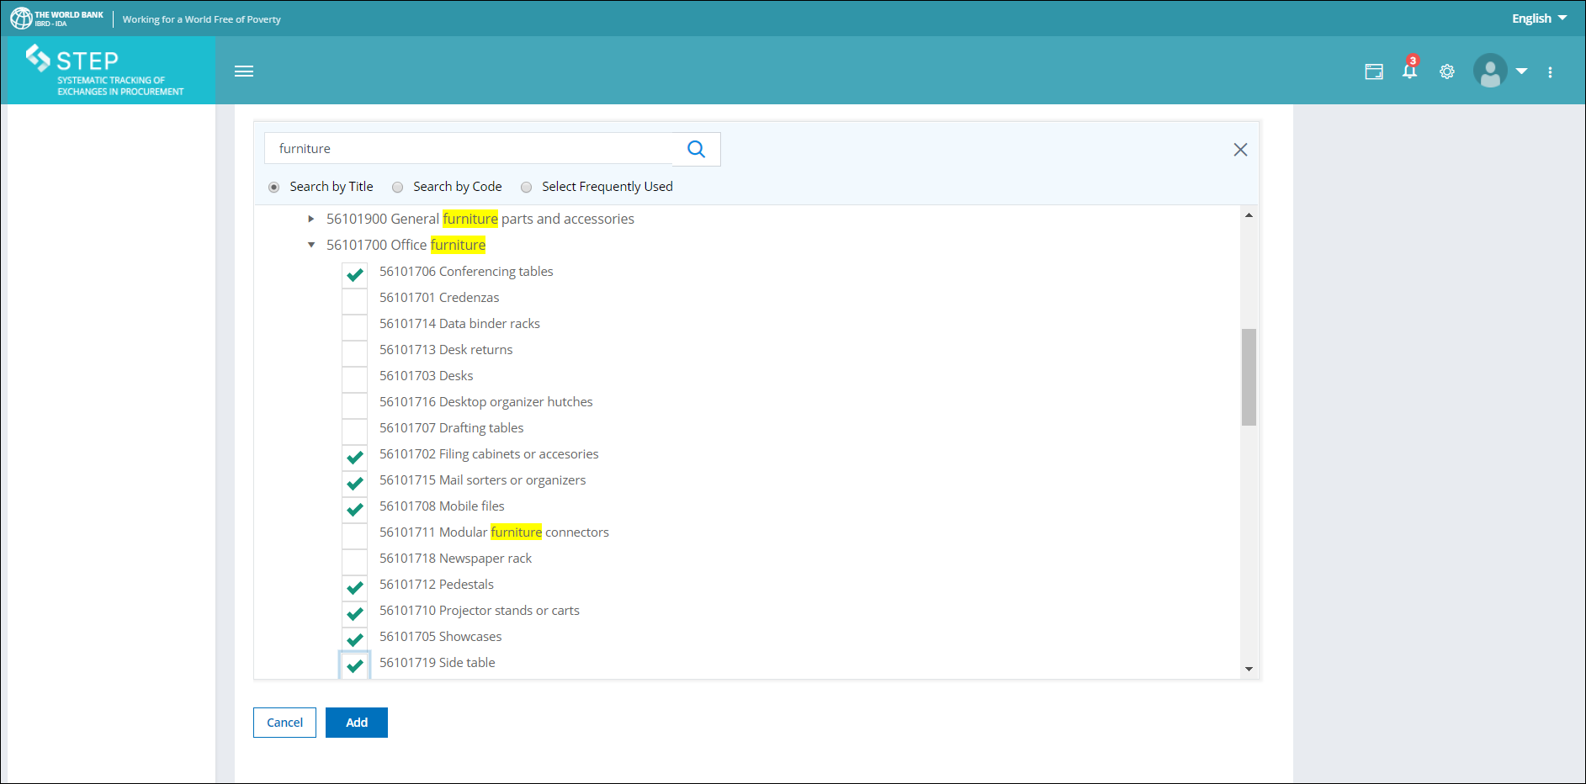
Create Activity
Adding Procurement Classification

Slide 36
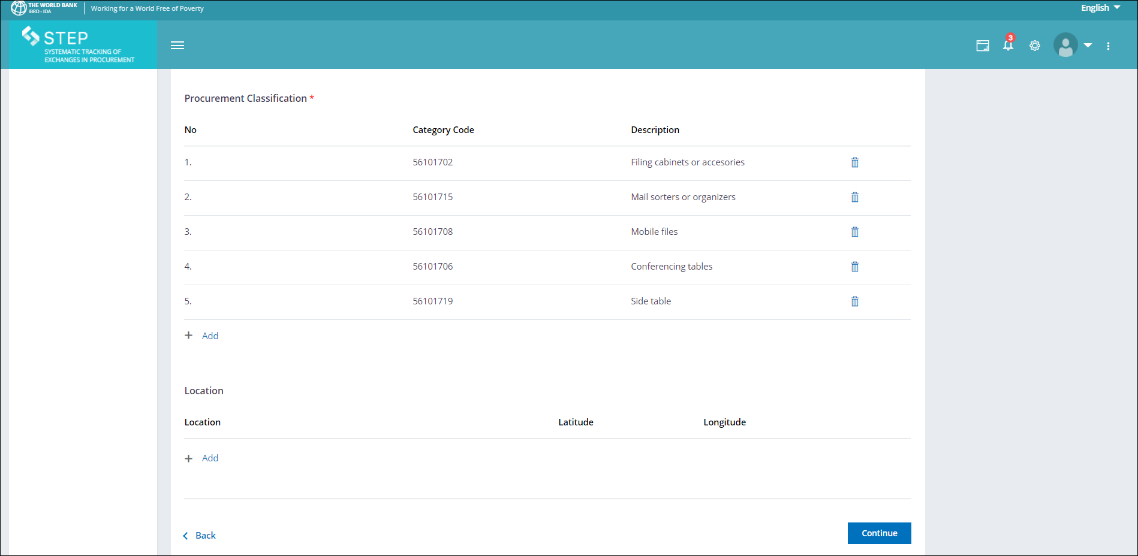
Create Activity
Procurement Classification………….. Contd.

Slide 37
STEP: UNSPSC
United Nation’s Standard Procurement Service Code [UNSPSC] use is mandatory
Product coding is used to classify goods and services.
Procurement Officers select one or more UNSPSC code to indicate the product or service their agency needs to procure or search for potential suppliers registered and accepted by one or more UN agency from the database.
It is, therefore, vitally important that you select the most accurate UNSPSC codes to describe your goods/services.

Slide 38
Create Activity
Location Feature – This tab appears below the Procurement Classification as shown below

Slide 39
Create Activity
Location Feature – How to add location ? However this is not a mandatory feature.
Click on the +Add button to add information…. However pls be mindful that only tabs that have a red (*) are mandatory and you may fill in the relevant information therein without fail.

Slide 40
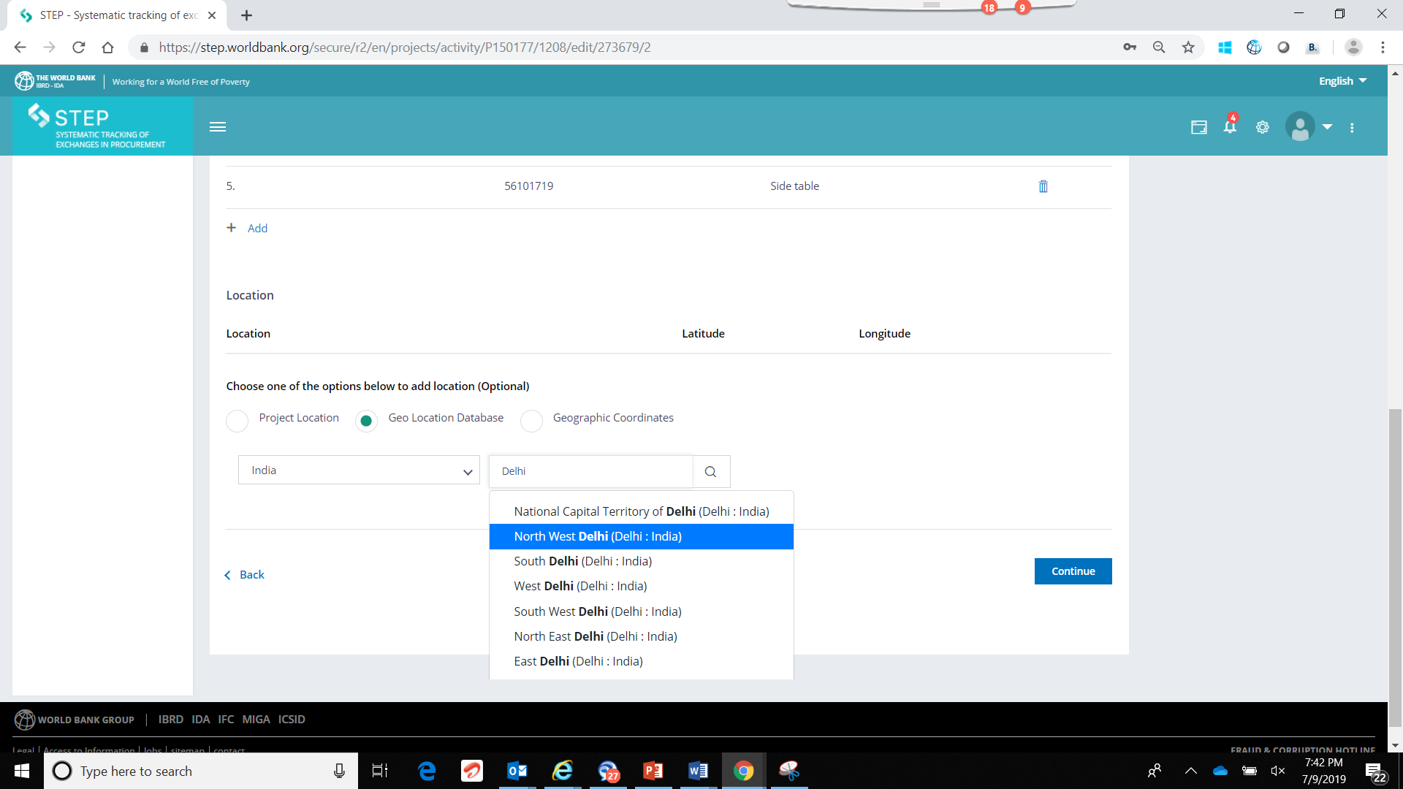
Create Activity
Location Feature – Optional and Not Mandatory
How to add location? Click on the +Add button

Slide 41
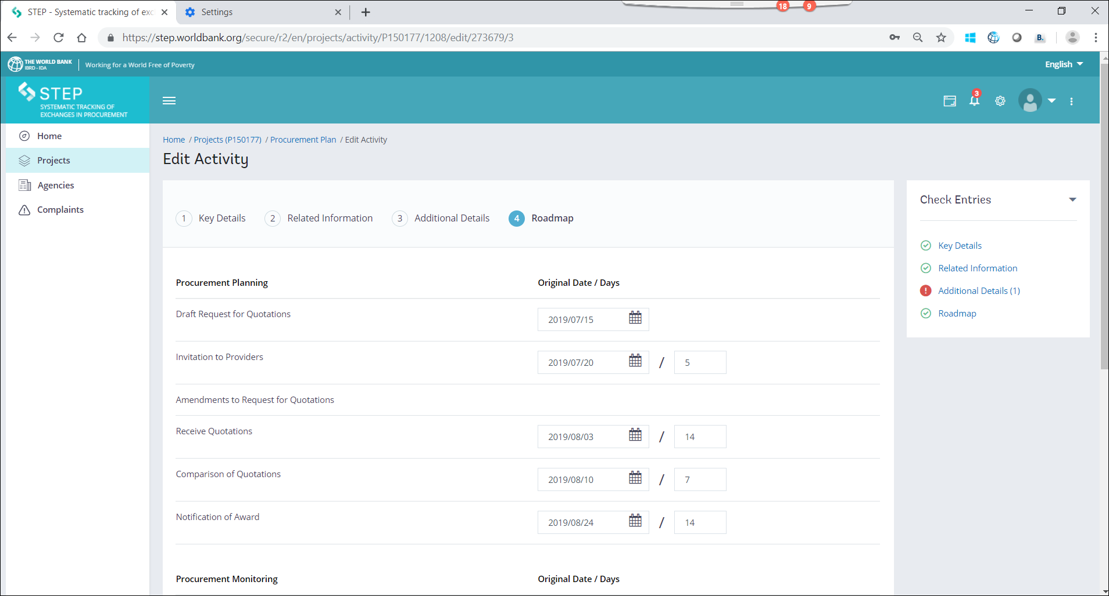
Create Activity
Roadmap Tab – Entering Procurement Planning dates sequentially on the tabs of the Roadmap

Slide 42
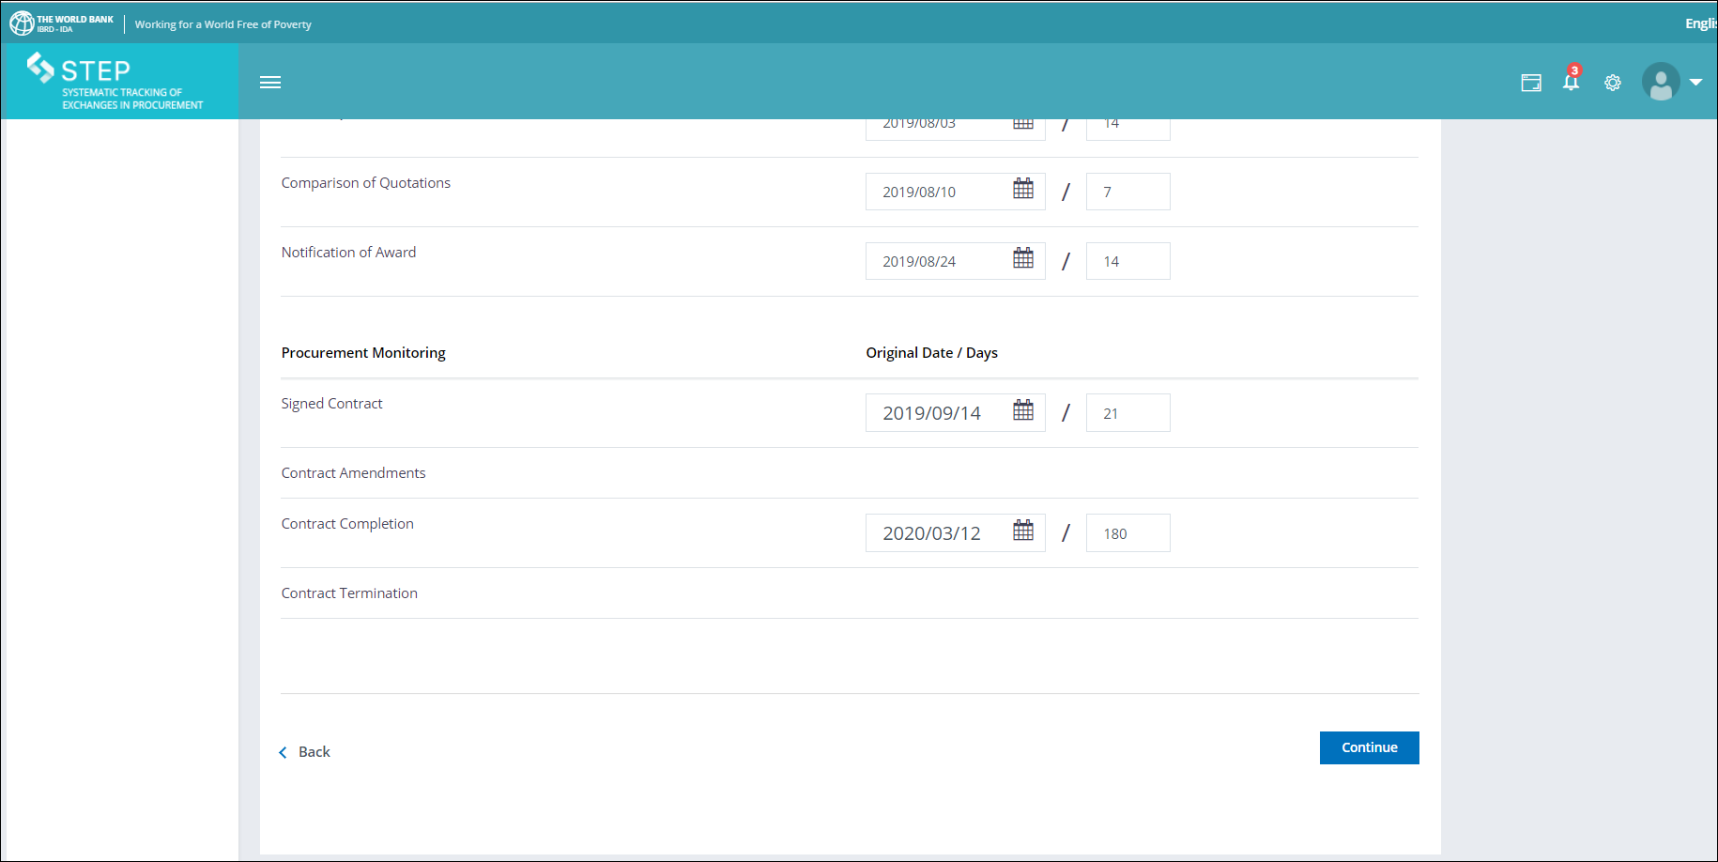
Create Activity
Roadmap Tab contd. ………………..
Once you click on Continue, you will be directed to the next interface shown on the next slide

Slide 43
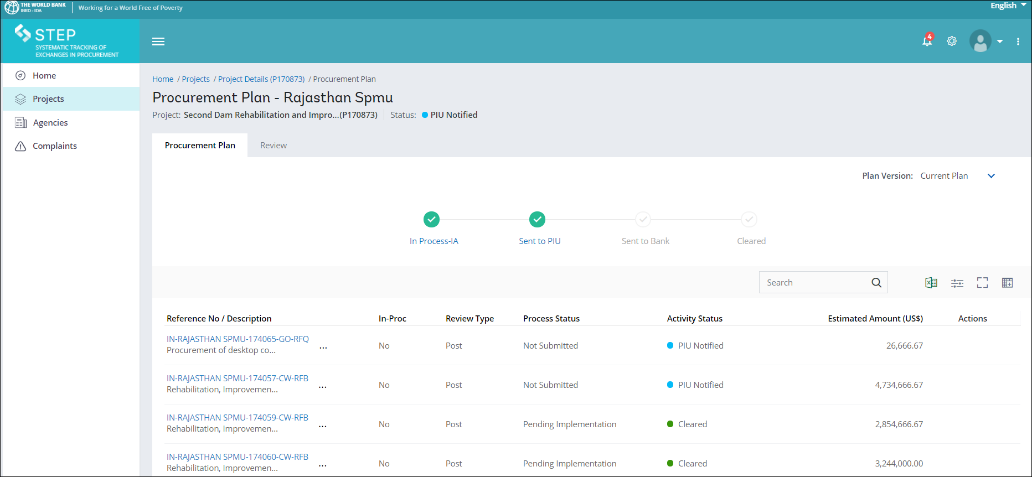
Procurement Plan Interface
Please note: In-process IA and Activity Status (New / Cleared / Modified/Returned)

Slide 44
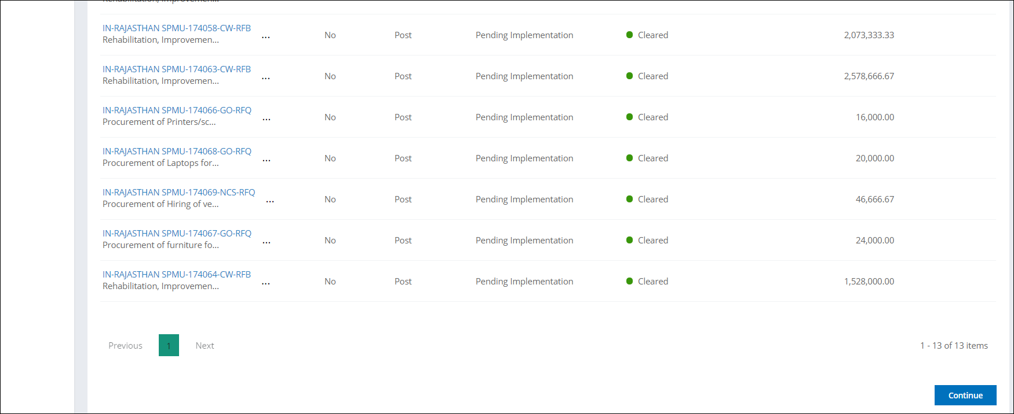
Procurement Plan Interface
Click on the *Continue* button at the bottom of the Procurement Plan page

Slide 45
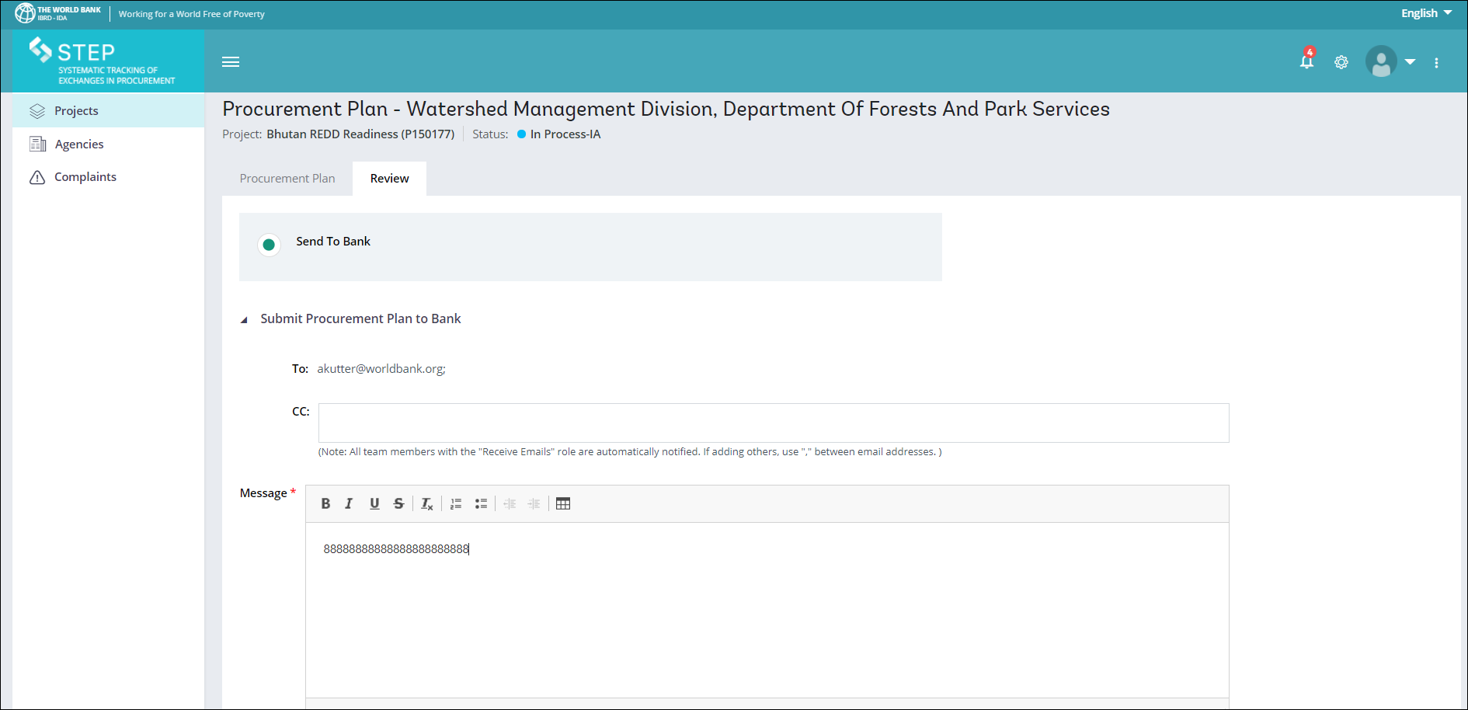
Procurement Plan Interface
Once you click on the Continue button at the bottom of the Procurement Plan page, you will be directed to the review tab shown below

Slide 46
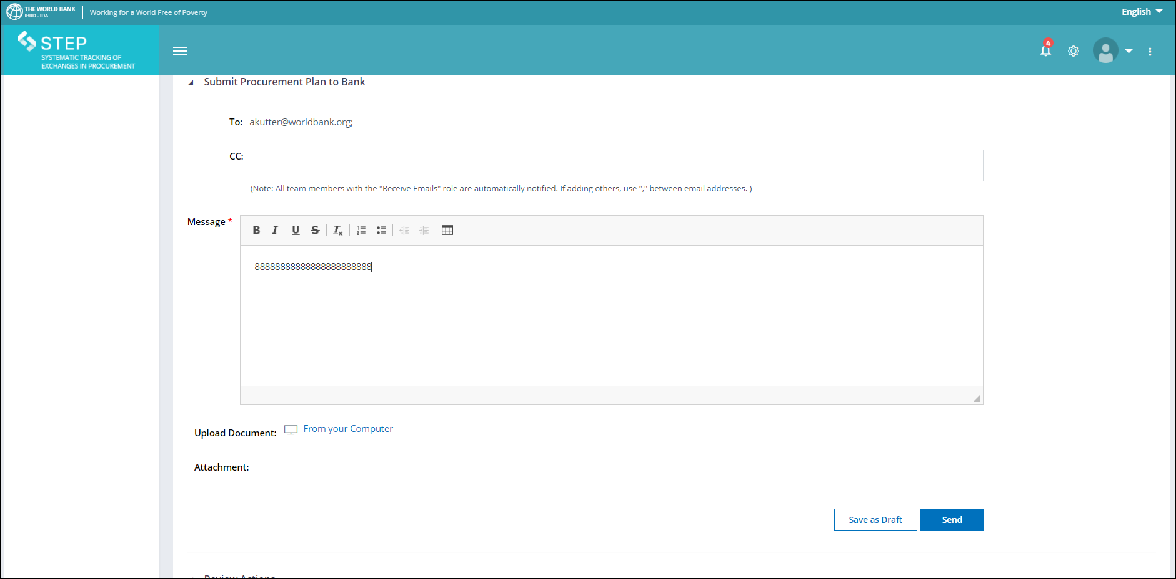
Procurement Plan Interface
Review tab………….contd.
Please fill in the Message Box and Click *Send* to Submit Procurement Plan to Bank

Slide 47
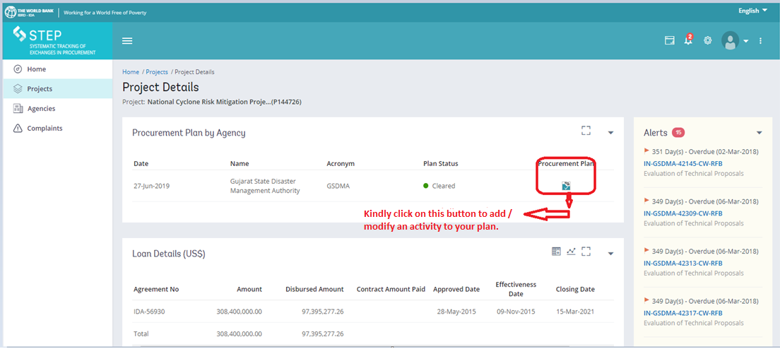
Accessing the procurement plan
Click on the Procurement Plan icon

Slide 48
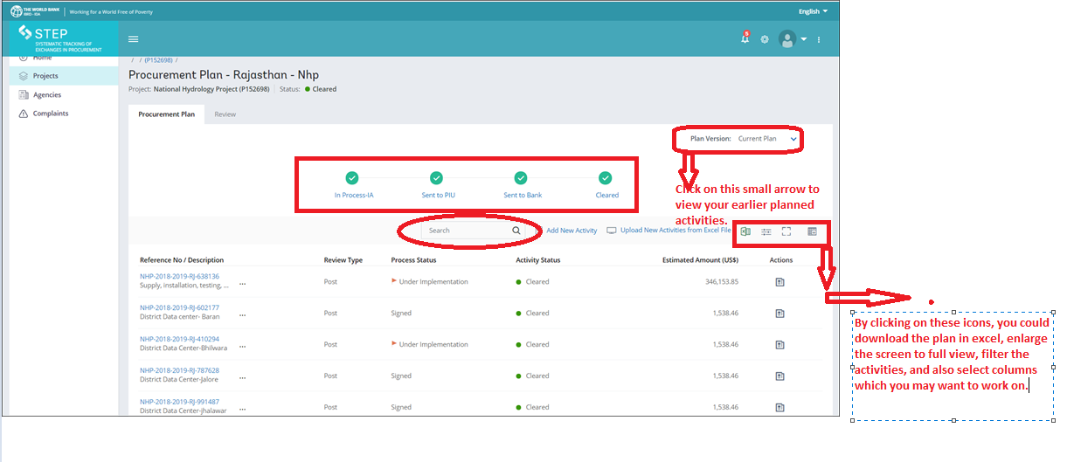
Accessing the procurement plan
Please note the status of the Procurement Plan below
Plan version & Search Feature. Procurement Plan dashboard has 4 icons in the same row as the Add Activity tab These 4 icons are for Export to Excel, Filters, Full Screen and Select Columns

Slide 49
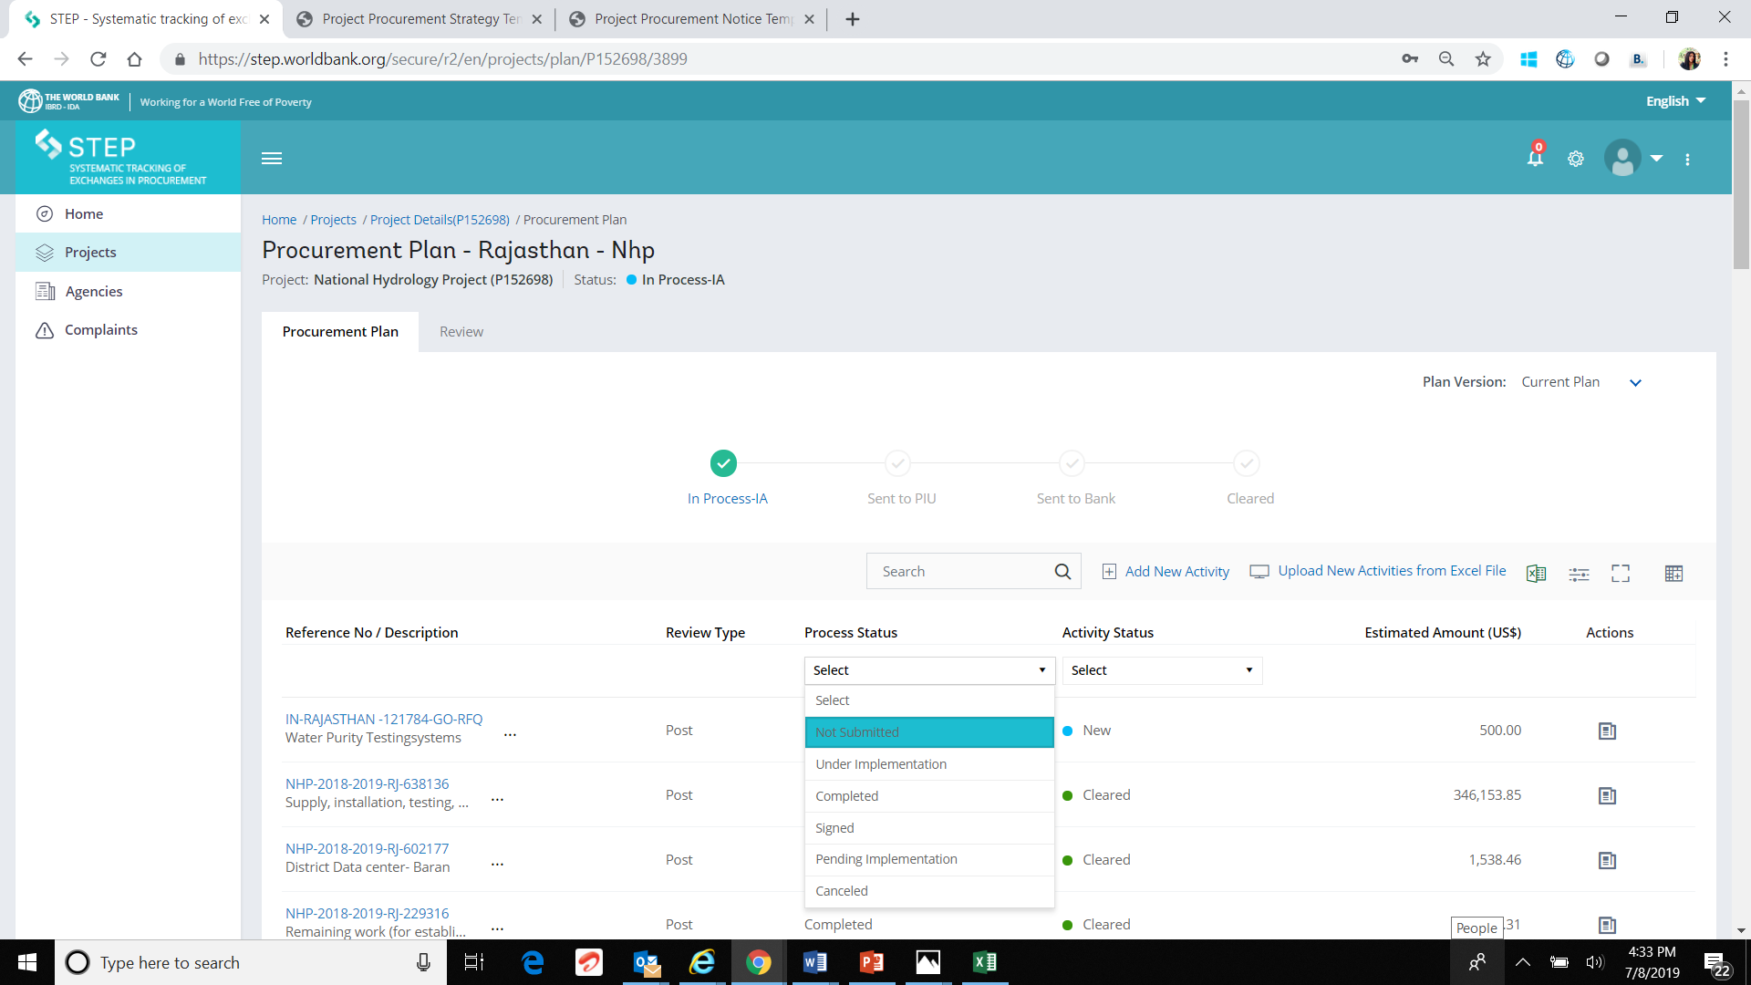
procurement plan interface
Filters icon feature – Process Status Filter is shown below

Slide 50
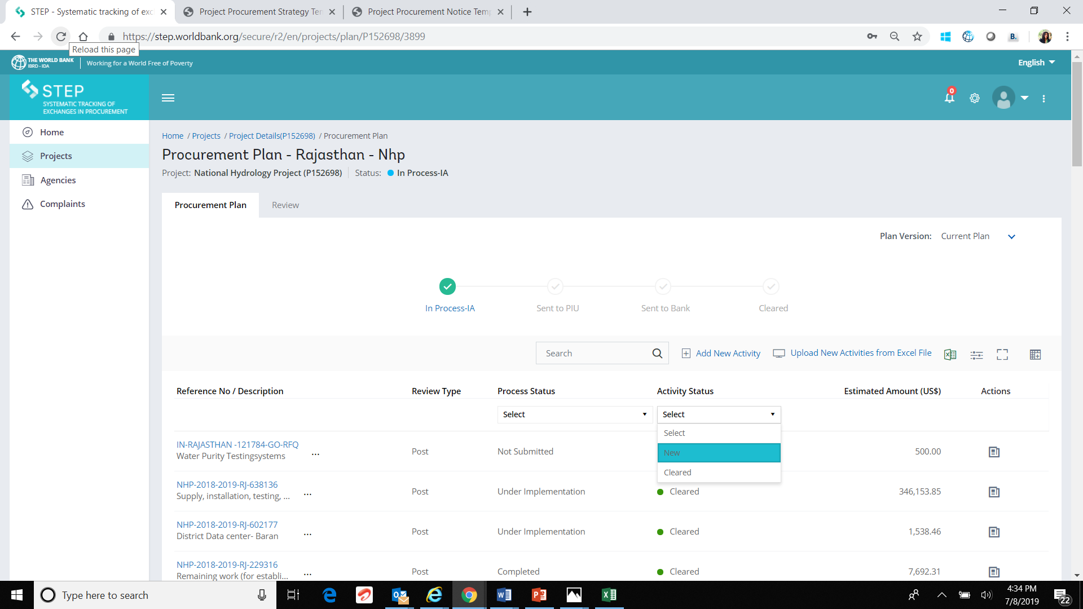
procurement plan interface
Filters icon feature – Activity Status Filter is shown below

Slide 51
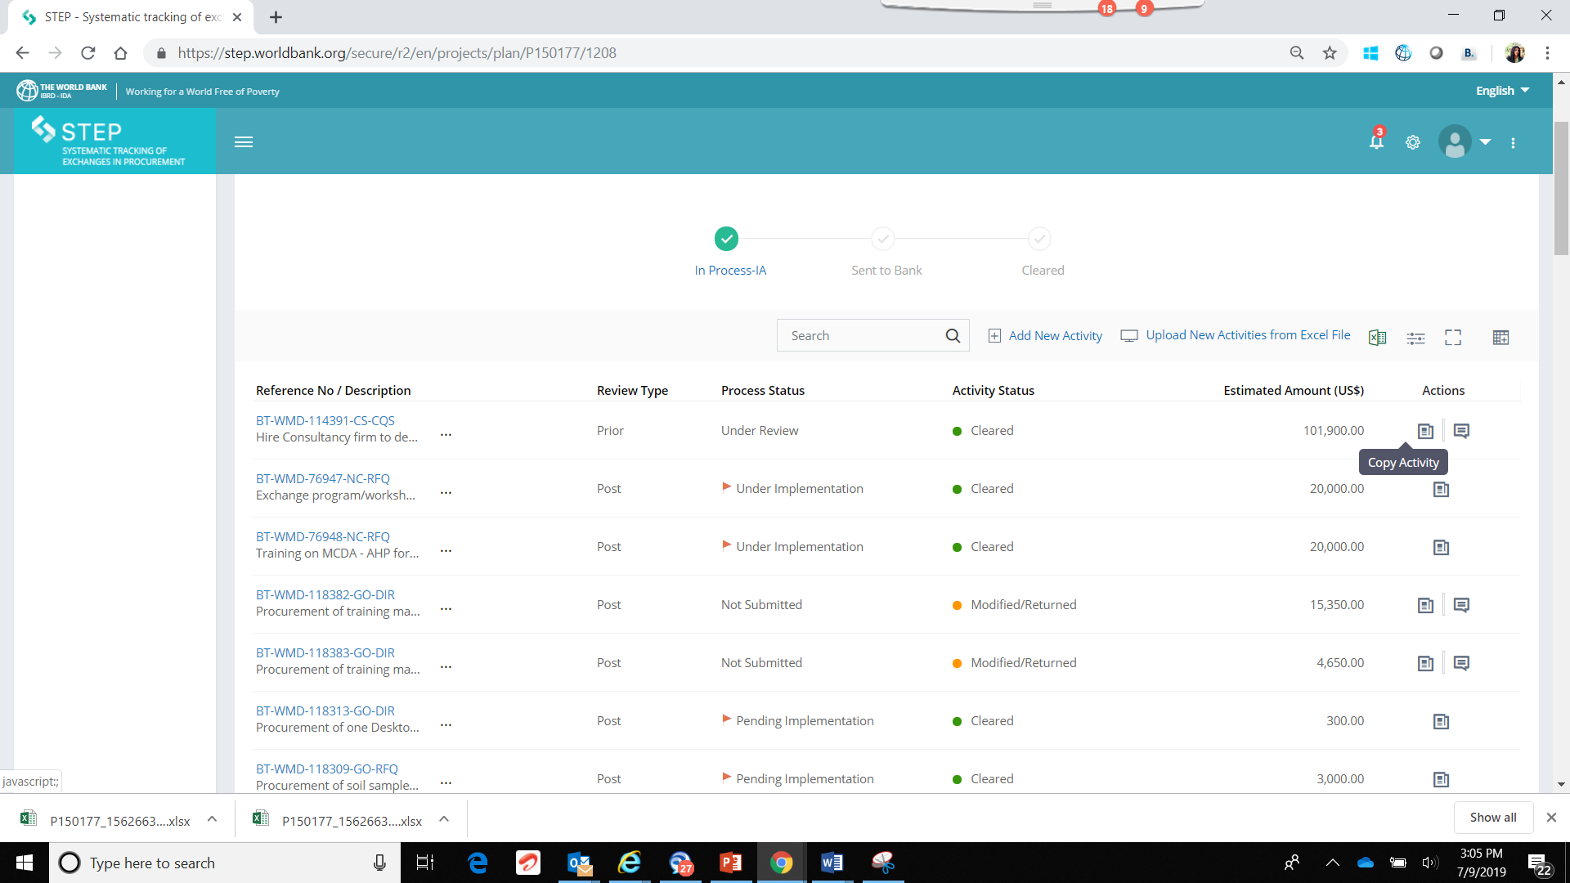
procurement plan interface
Copy Activity and Comments icon appear at the end of the row for each activity

Slide 52
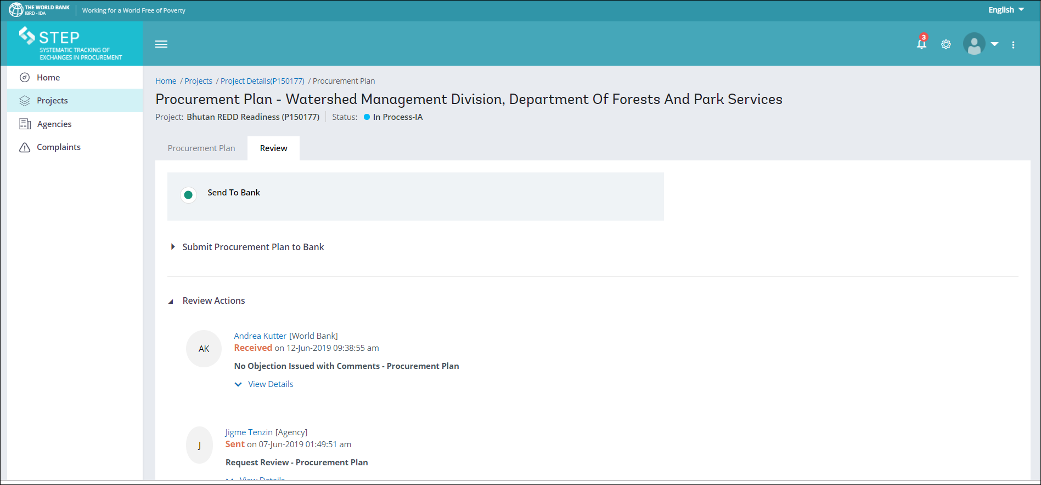
procurement plan interface
Review Tab which has 2 features – Send to Bank option and Review Actions which has a record of communication till date on the particular activity

Slide 53
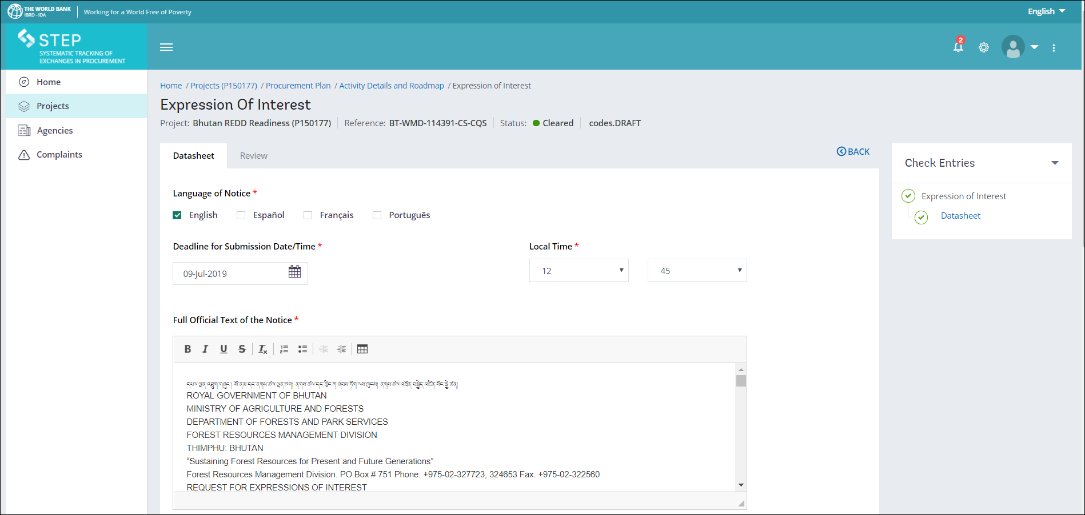
STEP : Creating a Specific Procurement Notice

Slide 54
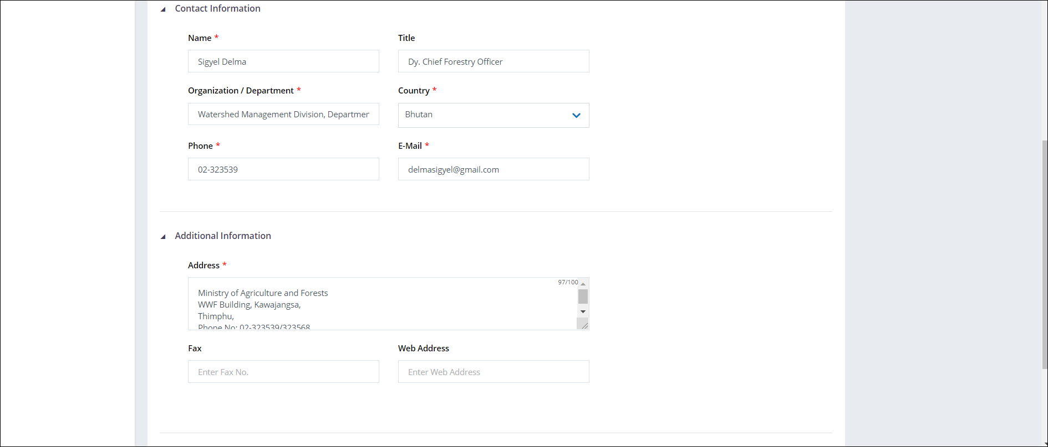
STEP : Creating a Specific Procurement Notice

Slide 55
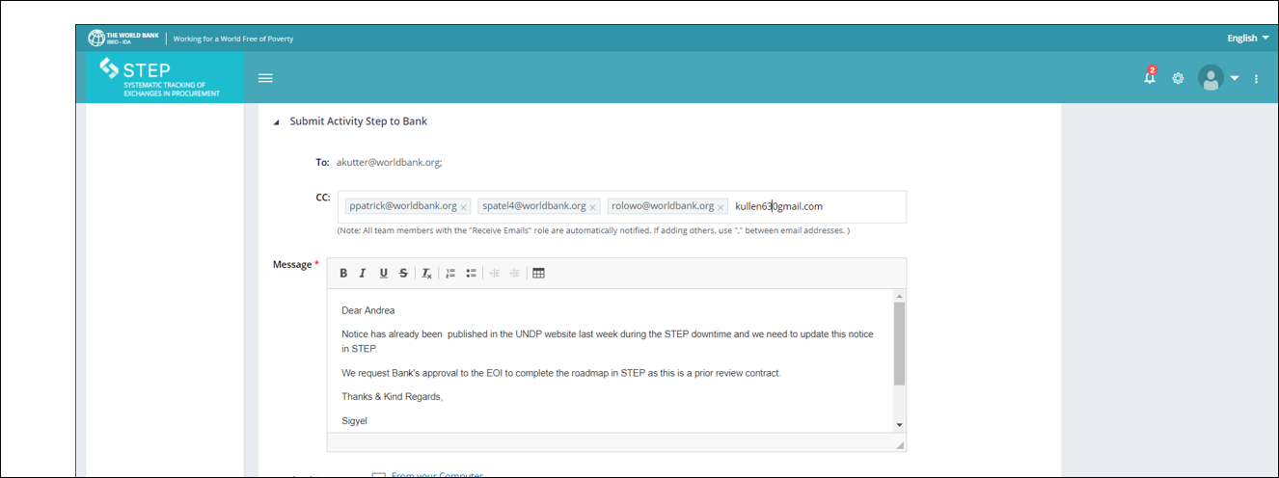
STEP : Creating a Specific Procurement Notice

Slide 56
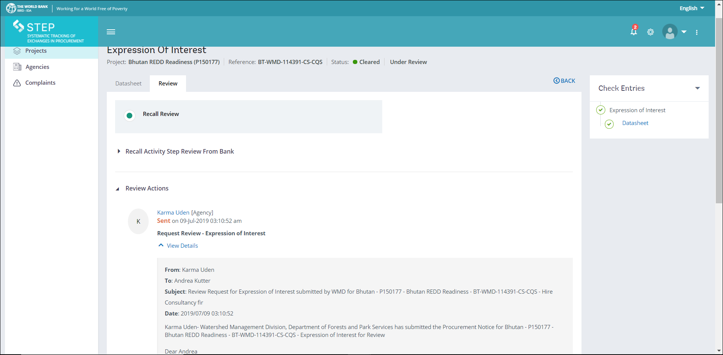
STEP : Creating a Specific Procurement Notice
Review tab has a copy of the Request Review which was sent to the Bank. This also has the Recall Review feature which is shown on the next slide.

Slide 57
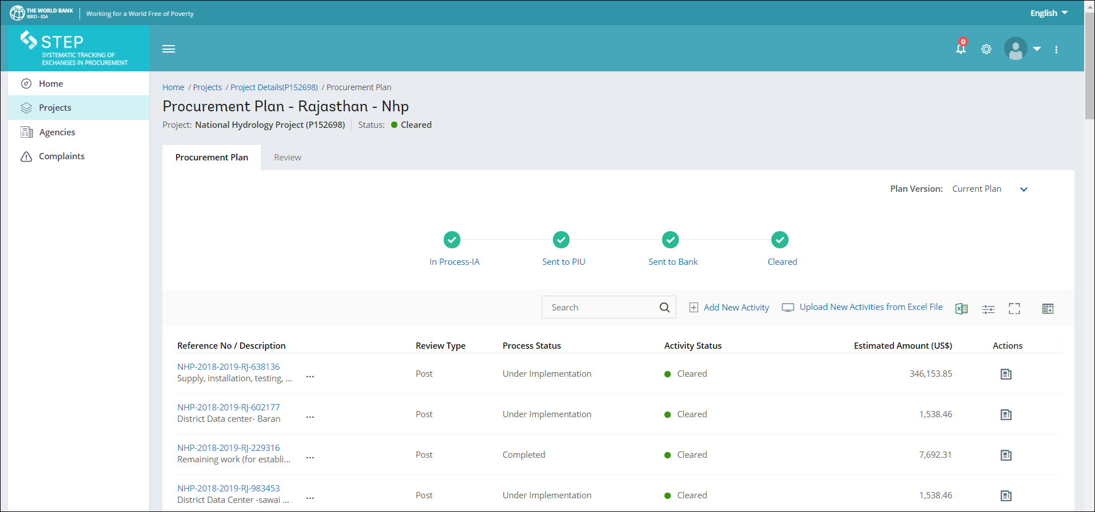
Add New Activity
Add New Activity once the current Procurement Plan has been approved by the Bank
You cannot add a New Activity if the Procurement Plan is pending with the Bank

Slide 58
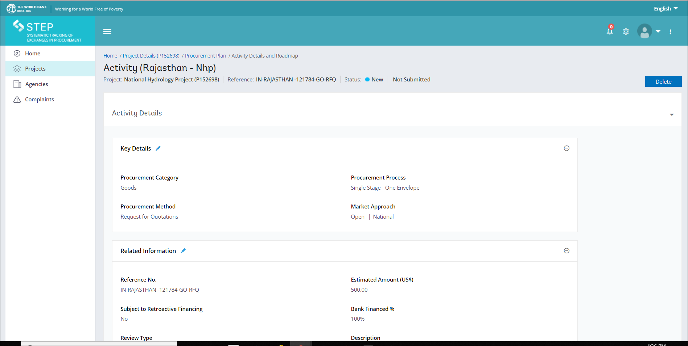
STEP: DELETE, CANCEL and MODIFICATION
Delete button option is available only for *New Activity* which has not yet been submitted to the Bank

Slide 59
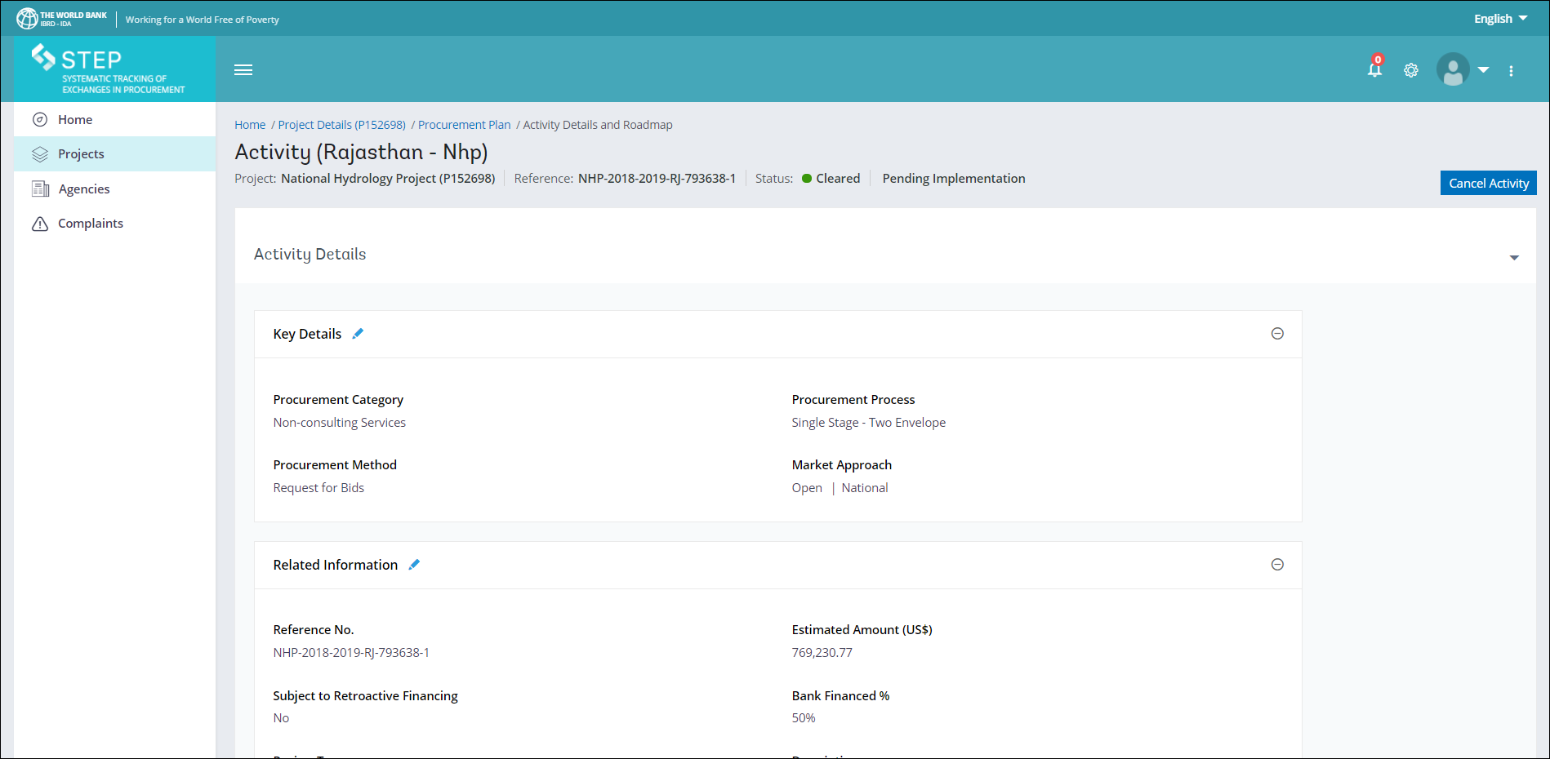
STEP: CANCEL and MODIFICATION
Cancelling a Cleared activity
Activities which are under*Pending Implementation* only are editable.. You may, in case of Cleared Activities, modify or cancel them but they are not deletable

Slide 60
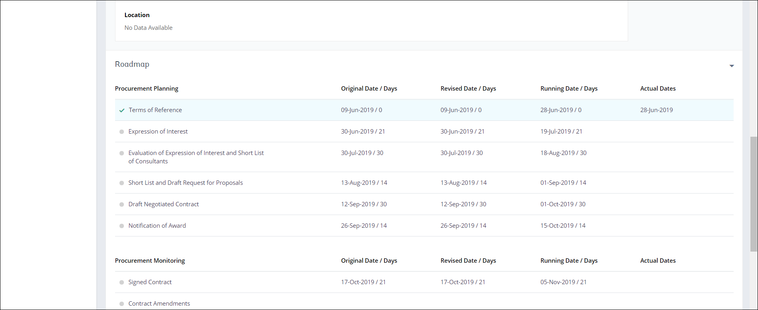
STEP : Creating a Specific Procurement Notice
Click on the Terms of Reference which is the first step on the Roadmap.. Once this stage is completed a Green *√* is formed which then allows us to move on similarly on the Roadmap.. Kindly ensure that the Actual Date is captured against each step in the roadmap prior to taking action on the next step.

Slide 61
STEP: Procurement roadmap

Slide 62
STEP: datasheet

Slide 63
STEP Enhancement: In-Process activities
In-Process activities are activities which are subject to Prior Review ONLY in which the borrower started the procurement process without first entering it in STEP and these activities need to be included as a part of the STEP Procurement Plan.
Please note that as part of the activity creation (or Regularization), Borrowers will need to
Create a modification to the Procurement Plan by creating/copying an activity, as well as
Submit the justification and endorsement for Accredited Procurement Specialist (APS) and Task Team Leader’s (TTL) acceptance explaining why the activity/s being added to the procurement plan are not starting at the first stage of the roadmap.

Slide 64
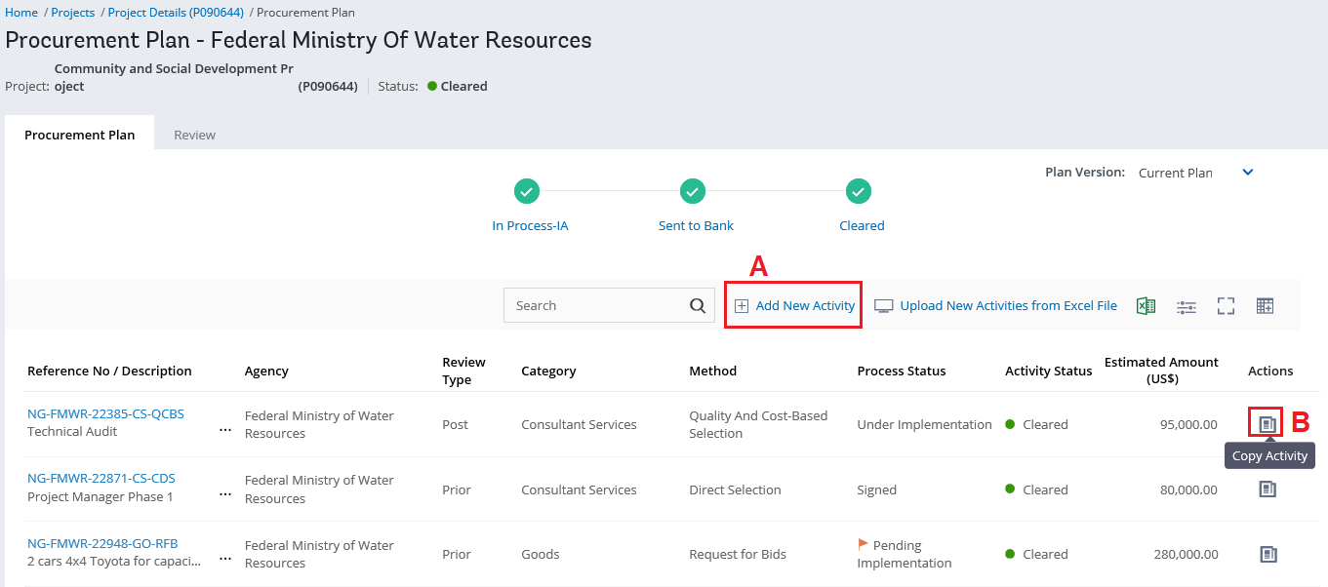
STEP Enhancement: In-Process activities
Borrower View / Process & Actions:
Borrower should access the system and (i) create a new activity within the Procurement Plan, or (ii) use the “Copy Activity” functionality of an existing activity. If “Copy Activity” function is used, please remember to Cancel the “original” one once it has been copied.

Slide 65
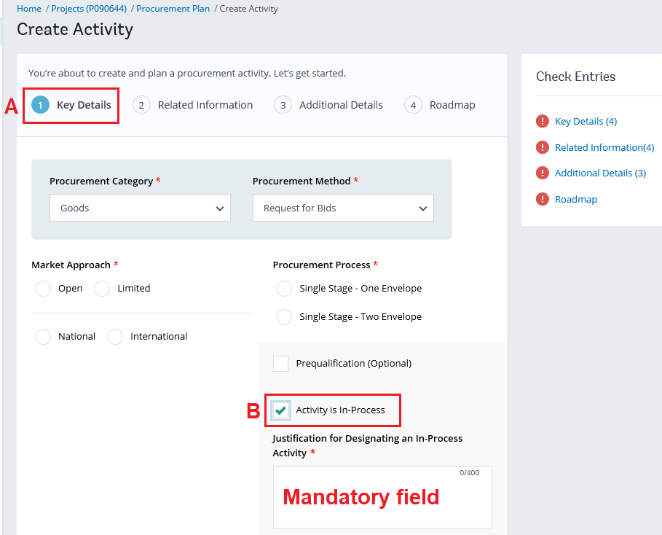
STEP Enhancement: In-Process activities
Within the “Key Details” section (see point A) of the activity, the Borrower will find at the bottom of the page the selection box “Activity is In-Process”, which should be selected.
Once selected, Borrower needs to enter a justification (brief description) explaining why the activity is being added to the procurement plan by not starting at the first stage (see point B). Please note that this is a mandatory field.

Slide 66
STEP Enhancement: In-Process activities
Borrower can request as many “Regularizations” or “Activity In-Process” as long the justification is valid for all of them.
Once the Borrower has “Regularized” the activity/s, Borrower should go to the “Review” tab of the Procurement Plan and prepare the e-mail that will be send to the Bank for No Objection.
Borrower should enter the text of the e-mail (see point C on the next slide) and as part of the process, Borrower should endorse a document that includes the Justification/Endorsement from the Project Director/Coordinator indicating the reason / justification why the activity should be “Regularized”. Please note that this endorsement document is mandatory.
Please note that without this document, the Borrower will not be able to send this request to the Bank; the buttons will not be “active” for submission.

Slide 67
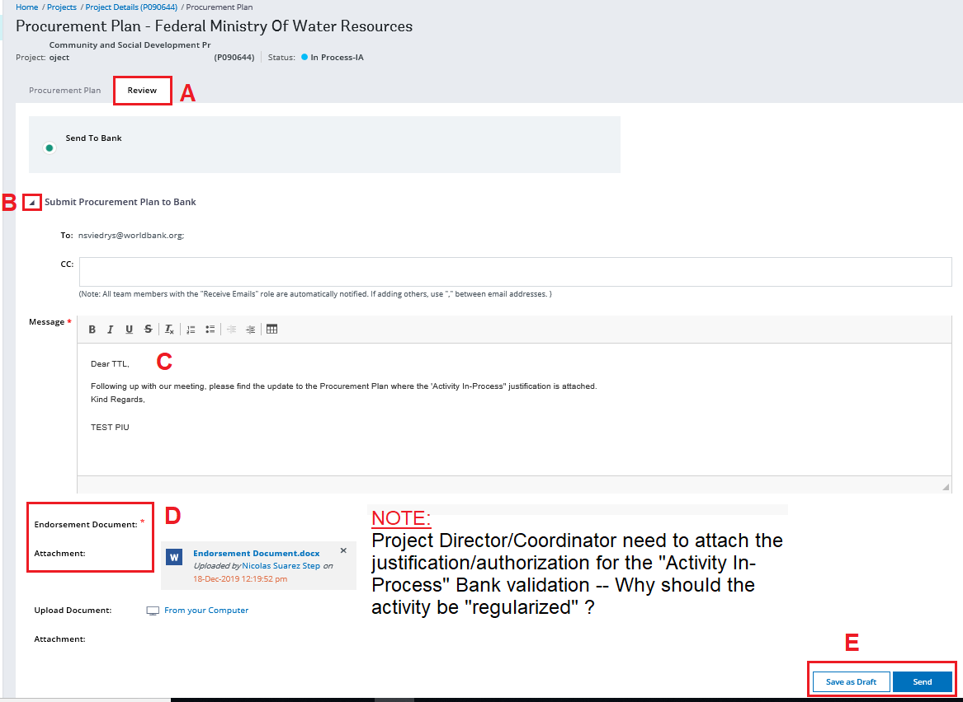
STEP Enhancement: In-Process activities

Slide 68
STEP Enhancement: Check Entries
A new Check Entries feature has been implemented to indicate completeness of a process.
Users will now be able to see which sections are complete and which are missing information highlighted.
Clicking on a red highlighted item will take the user to that section and highlight what's missing.
Once all the required data for a section has been entered, the indicator beside that section will turn green

Slide 69
STEP Enhancement: Roadmap STEPS
All roadmap steps have been redesigned for ease of data entry and navigation
New ‘Documents’ tab – All document related functionality has been moved to a ‘Documents’ tab within each step
New ‘Datasheet’ tab – All datasheet related functionality has been moved to a ‘Datasheet’ tab within each step
New ‘Review’ tab – All review actions and communications have been moved to the ‘Review’ tab within each step
Indicator for complete steps – After Bank gives No Objection to a step, the indicator beside the step on the roadmap would show green
Indicator for in progress steps – When user starts working on a step, the indicator beside the step on the roadmap would show blue

Slide 70
STEP Enhancement: Document Tab
All document related functionality has been moved to a ‘Documents’ tab with separate sections for Mandatory and Supporting documents.
Upload multiple documents at once – User will now be able to select and upload multiple documents at once
Switching document types – Uses will now be able to use the switch icon to move documents from one section to another to easily change the document type
Perform actions while document upload is in progress – User will no longer have to wait for the document upload to complete to perform other actions like uploading more documents, adding comments to already uploaded documents, delete documents, etc.

Slide 71
STEP Enhancement: Review Tab
The Review Actions throughout the system has been moved to a new ‘Review’ tab specific to where the action is being done.
Review Actions – All review actions like ‘Send to Bank’, ‘Recall’, etc will now be done in the Review tab.
Send to Bank/PIU - When user clicks ‘Continue’ after the documents have been uploaded and/or datasheet has been completed and the step is ready to be sent for review, they will be taken to the Review tab for Send action. The email body would be automatically opened for entry.
Recall - When user clicks ‘Continue’ after a review has been requested, they will be taken to the Review tab for Recall action. The email body would be automatically opened for entry.
Review History - All communications between IA/PIU, IA/Bank, PIU/Bank for procurement plan or roadmap steps will now be logged in the Review tab to maintain consistency. Communication Log has been removed from the system.

Slide 72
STEP Enhancement: Shortlist
The shortlist has been moved to a separate tab within the datasheet. All actions on the shortlisted suppliers like making joint ventures, editing supplier information or adding parent affiliation information can be done here:
Redesigned Add Shortlist screens – Users will now be able to easily pick firms from any or all of the 3 lists (Agency List, UN List and World Bank List). The suppliers have been grouped by country for easier identification. Search feature has been provided with each list to get to the required firms faster.
New Joint Venture functionality – Users will now be able to enter a Supplier name in 1 or more Joint Ventures with different suppliers for separate Lots

Slide 73
STEP Enhancement: Consultant Datasheet
The datasheet for the category ‘Consultants’ has been majorly redesigned. This will now follow the same pattern as the Goods and Works datasheet
Scores & Prices – This has been removed from the supplier shortlist table
Evaluation at Contract Level – User will now be able to list the suppliers with different contracts and evaluate them at the contract level instead of at the supplier level like good and works
Identifying Awarded, Evaluated and Rejected Suppliers – User will now be able to identify who the rejected, evaluated and recommended bidders for each contract and enter scores and prices specific to the contract
Please note - if the activity is post review the Borrower can verify the Supplier’s eligibility from this external link https://www.worldbank.org/en/projects-operations/procurement/debarred-firms

Slide 74
STEP Enhancement: Notification of Award Step
This step has been redesigned for better user experience.
Contract Listing – Users will now be able to see the list of contracts that have been cleared and/or completed standstill and ready to be generated. User will now have to generate contracts one by one, with or without changes:
Separate Tabs for Cleared, Modified and Awarded Contracts
Once a contracts is sent to Bank with no changes, it gets listed in a new ‘Awarded Contracts’ tab.
Once changes are done to a contract, it gets listed in the ‘Changed Contracts’ tab and once a contract is sent to bank for review with changes, it gets moved to the Under Review section in the same tab.
After Bank clears the updated contract, it get listed in the Awarded Contracts tab
Singed as Evaluated – User will be able to select the contract and notify without any changes (No Changes)

Slide 75
STEP Enhancement: Contract Monitoring Steps
Users will now be able to see only the list of contracts that are applicable and ready to be acted upon at a particular step
At Signed Contract, users will now only see the list of contracts that have been generated and ready to be signed.
At Contract Amendment, Contract Termination and Contract Completion., users will only see the list of contracts that have been signed and can be amended or terminated or completed if required
Contract Award Notice – Easy access to the Contract Award notice from the Contract Listing page

Slide 76
STEP Enhancement: Recall No Objection
A new feature now available for all No Objections sent in the system on the Bank side.
Recall No Objection button - TTL will now have a button to recall the No Objection
This button will only be available for 48 hours after issuing the No Objection or until Borrower takes any action.

Slide 77
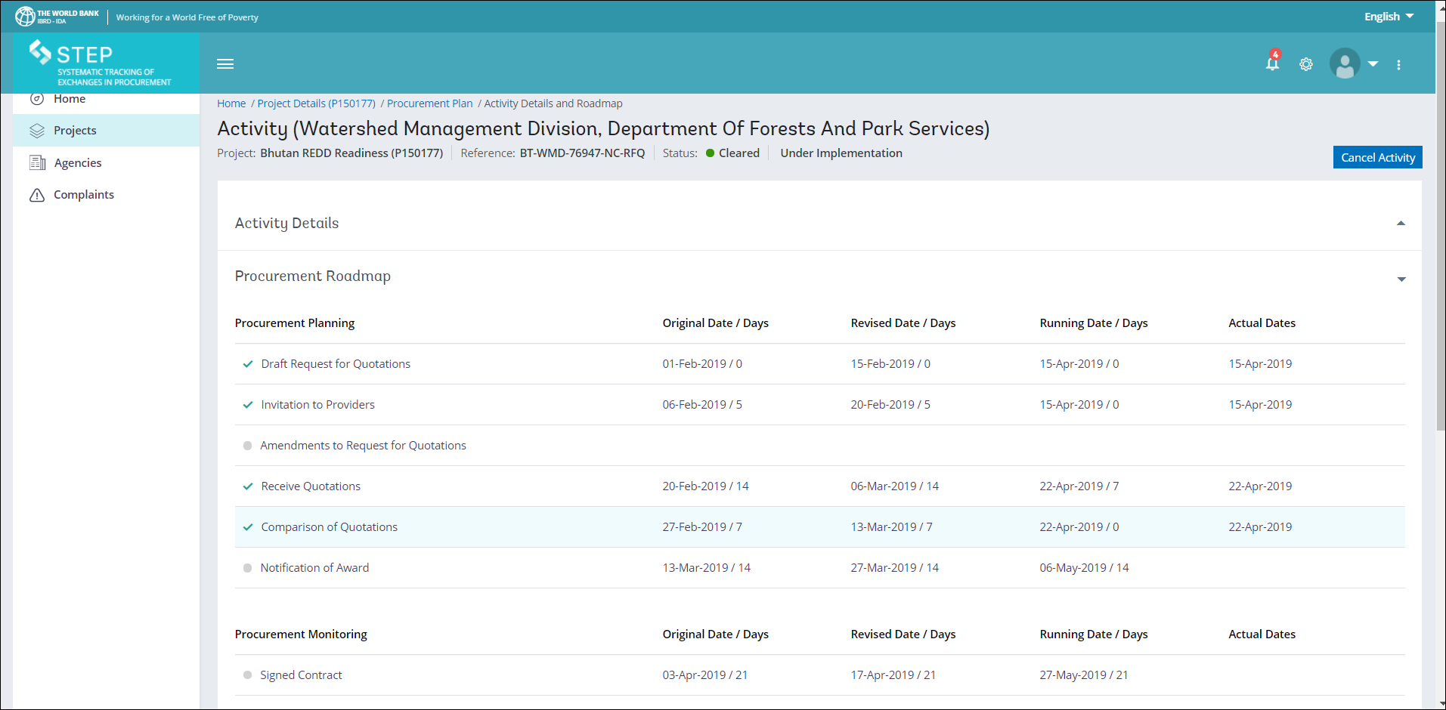
STEP: Complaints
Complaints under any activity is to be updated in the system by the IA responsible. The Agency User Creates/Edits Complaint, Sends it to the Bank in case of Prior review activity, and until the same is resolved, the IA should not move forward with the activity implementation. For post review activities, only after taking appropriate action, and resolving the Complaint, the IA may move forward with the activity implementation

Slide 78
STEP: Complaints

Slide 79
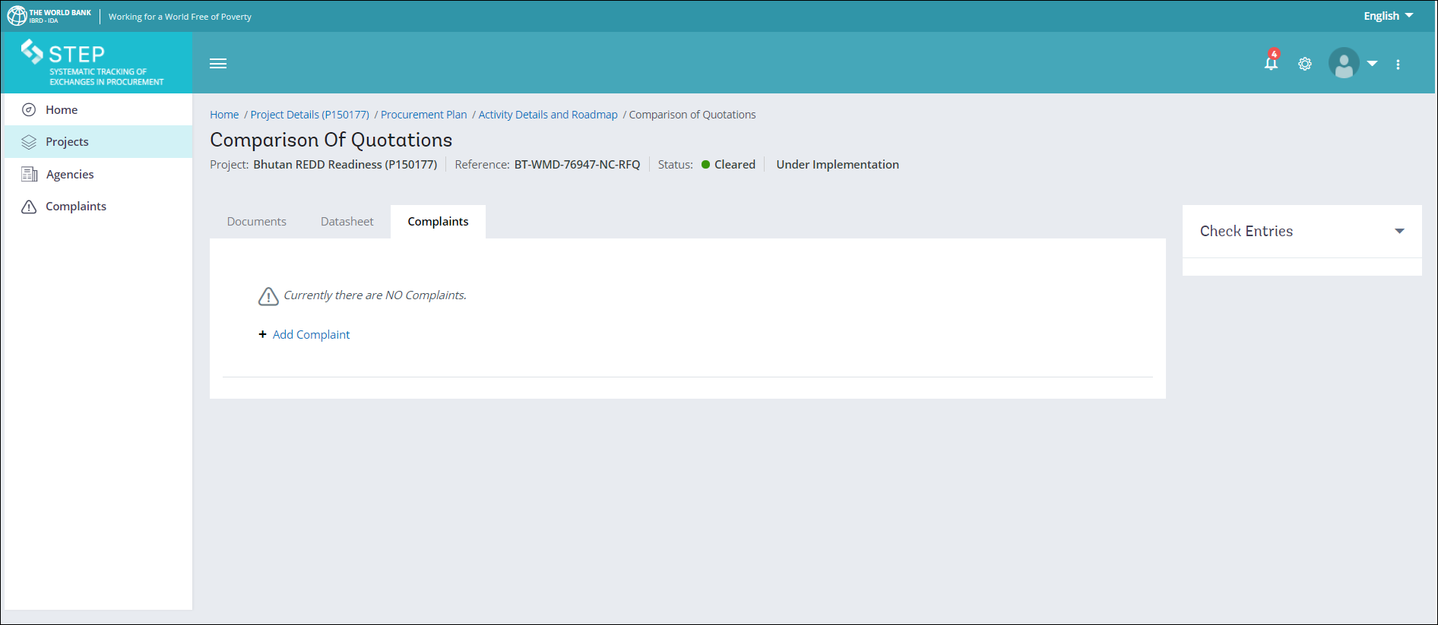
STEP: Complaints
Click on Add Complaint ONLY at the specific stage of the roadmap which is pertaining to the complain.

Slide 80
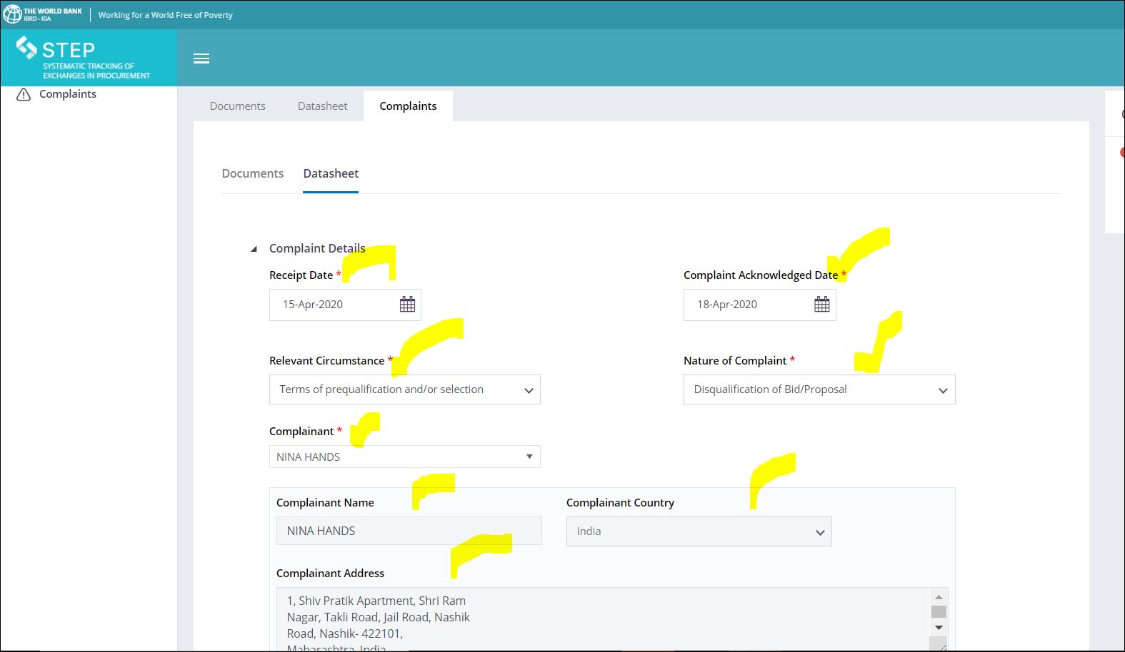
STEP: Complaints
Add Complaint……………………contd.
Fill up the details as requested in the Datasheet in the Complaints section

Slide 81
STEP: Complaints
Add Complaint……………………contd.
Click on Continue button at the bottom of the page after entering all the mandatory information in the fields marked with a red star

Slide 82
STEP Enhancement and there after … Handling Complaints Module in STEP (Q & A).
STEP: Complaints FAQs
Are Borrowers required to record in STEP Complaints received for projects subject to the Guidelines?
Yes, Borrowers are required to record all Complaints in STEP both for projects subject to the Procurement Regulations (for projects approved after July 1, 2016) as well as for those subject to the Procurement Guidelines and the Consultants’ Guidelines (for projects approved before July 1, 2016).
Should Complaints received on contracts not subject to the World Bank’s prior review be recorded in STEP?
Yes, all Complaints received by the Borrower should be recorded in STEP for both contracts subject to the World Bank’s prior review as well as Post-Review Contracts.
Should Complaints received on contracts subject to national procurement procedures (NPP) be recorded in STEP?
Yes, Complaints received under contracts subject to NPP are handled in accordance the applicable complaint review rules and procedures as agreed by the World Bank and shall be recorded in STEP.
Does the World Bank monitor the handling of Complaints for contracts not subject to the World Bank’s prior review?
Yes, as part of its implementation support and oversight, the World Bank monitors how Borrowers handle Complaints received on all contracts to ensure that they are addressed promptly and fairly. However, for contracts not subject to prior review, Borrowers are not required to submit the proposed draft response to the Complaint for the World Bank’s review prior to its issuance to the complainant. When selecting a sample of contracts to be post reviewed, contracts that have a Complaint will be prioritized.

Slide 83
STEP Enhancement and there after ….(Q & A Contd) ..
STEP: Complaints FAQs
How does STEP support Borrowers to address Complaints?
STEP supports Borrowers to adhere to relevant procedures by not allowing users to record the next stage of the procurement process until the Complaint has been addressed. It promotes transparency by supporting the Borrower to maintain relevant information and records. STEP will also provide analytics on Complaints that can inform future risk management and procurement strategies and planning.
Are Borrowers required to record the debriefing of bidders in STEP?
Yes, Borrowers shall promptly record in STEP all requests for debriefings including the results of the debriefings provided to interested parties.
Should Borrowers record Complaints received prior to February 4, 2019 in STEP?
Borrowers are required to record in STEP all Complaints received on or after February 4, 2019. Complaints received prior to February 4, 2019, but for which Borrowers have not responded to the complainants should also be recorded in STEP except those Complaints for which Borrower’s draft proposed response was submitted for the World Bank’s review prior to February 4, 2019. Likewise, all requests for debriefings received on or after February 4, 2019 and debriefings provided after this date shall be recorded in STEP.

Slide 84
STEP Enhancement and there after …(Q & A Contd.).
STEP: Complaints FAQs
Should Borrowers record Complaints received under Program for Results (PforR) operations in STEP?
No, Borrowers are only required to record in STEP those Complaints received under Investment Project Financing (IPF) operations. Likewise, Complaints received under IPF components of hybrid operations with both PforR and IPF components should be recorded in STEP. Complaints received under PforR operations are processed in accordance with the agreed program fiduciary systems.
What happens if Borrowers do not record Complaints in STEP?
The Procurement Regulations require Borrowers to record Complaints in STEP. Not recording Complaints in STEP constitutes procurement noncompliance.

Slide 85
Online resources
More information on the STEP Complaint Management System is available in the e-learning manual on the Bank’s website. Weblink is given below:
https://wbnpf.procurementinet.org/e-learning-programs

Slide 86
STEP: Things to remember
Only the Implementing agency officials who are involved with the actual Project Procurement should be registered in STEP. The concerned officials must be involved in ongoing project procurement activities.
Please ensure that the user email id registered in STEP is an active email id as all STEP related correspondence pertaining to the registered user will be sent to his registered email id and even in case an user wishes to reset the password, the reset password link will be sent to the user’s registered email id.
The registered Point of contact of an implementing agency should monitor the current procurement activities in STEP paying special attention to the timelines incorporated in the Roadmap for each activity.
Even in case of Post Review contracts, the client needs to complete each stage of the Procurement Roadmap in STEP.
Please ensure that you delete the cache files in your browser before you login to STEP as many users experience technical errors due to cache/history files in their browser.
Please ensure that all the amendments and modifications to various ongoing Procurement activities are recorded on the activity roadmap in STEP
All fields marked with a RED Asterix * are mandatory fields and you cannot skip entering information in these fields.
Please remember to use the Back and Continue buttons on each page to navigate between different tabs pertaining to an activity

Slide 87
Questions

